Slide 1
Frame Buffer
0 0 0 0 0 0 0 0 0 1 0 1 0 0 0 0 0 0 0 0
0 0 1 0 0 0 0 0 0 0
0 0 0 1 0 0 0 0 0 0
0 0 0 0 1 0 0 0 0 0
Screen
1
Electron
Gun
Frame Buffer
Computer Graphics, Nepal College of Information Technology, 2009

Slide 2
Frame Buffer
0 0 0 0 0 0 0 0 0 1 0 1 0 0 0 0 0 0 0 0
0 0 1 0 0 0 0 0 0 0
0 0 0 1 0 0 0 0 0 0
0 0 0 0 1 0 0 0 0 0
1
r
Screen
0 0 0 0 0 0 0 0 0 1 0 1 0 0 0 0 0 0 0 0
0 0 1 0 0 0 0 0 0 0
0 0 0 1 0 0 0 0 0 0
0 0 0 0 1 0 0 0 0 0
1
0 0 0 0 0 0 0 0 0 0 0 1 0 0 0 0 0 0 0 0
0 0 1 0 0 0 0 0 0 0
0 0 0 1 0 0 0 0 0 0
0 0 0 0 1 0 0 0 0 0
0
Electron
Guns
Frame Buffer
Computer Graphics, Nepal College of Information Technology, 2009

Slide 3
Frame Buffer
0 0 0 0 0 0 0 0 0 1 0 1 0 0 0 0 0 0 0 0
0 0 1 0 0 0 0 0 0 0
0 0 0 1 0 0 0 0 0 0
0 0 0 0 1 0 0 0 0 0
1
r
Screen
0 0 0 0 0 0 0 0 0 1 0 1 0 0 0 0 0 0 0 0
0 0 1 0 0 0 0 0 0 0
0 0 0 1 0 0 0 0 0 0
0 0 0 0 1 0 0 0 0 0
1
0 0 0 0 0 0 0 0 0 1 0 1 0 0 0 0 0 0 0 0
0 0 1 0 0 0 0 0 0 0
0 0 0 1 0 0 0 0 0 0
0 0 0 0 1 0 0 0 0 0
1
Electron
Guns
R G B
1 1 white
0 1 0 green
1 0 0 red
0 0 1 blue
1 1 0 yellow
0 1 1 cyan
0 1 purple
0 0 0 black
Frame Buffer
Computer Graphics, Nepal College of Information Technology, 2009

Slide 4
Frame Buffer
Total number of intensities achievable = 2^{n}
out of a single pixel on the screen n = number of
bits assigned to
a single pixel
0 0 0 0 0 0 0 0 0 1 0 1 0 0 0 0 0 0 0 0
0 0 1 0 0 0 0 0 0 0
0 0 0 1 0 0 0 0 0 0
0 0 0 0 1 0 0 0 0 0
0 0 0 0 0 0 0 0 0 1 0 1 0 0 0 0 0 0 0 0
0 0 1 0 0 0 0 0 0 0
0 0 0 1 0 0 0 0 0 0
0 0 0 0 1 0 0 0 0 0
0 0 0 0 0 0 0 0 0 1 0 1 0 0 0 0 0 0 0 0
0 0 1 0 0 0 0 0 0 0
0 0 0 1 0 0 0 0 0 0
0 0 0 0 1 0 0 0 0 0
0 0 0 0 0 0 0 0 0 1 0 1 0 0 0 0 0 0 0 0
0 0 1 0 0 0 0 0 0 0
0 0 0 1 0 0 0 0 0 0
0 0 0 0 1 0 0 0 0 0
0 0 0 0 0 0 0 0 0 1 0 1 0 0 0 0 0 0 0 0
0 0 1 0 0 0 0 0 0 0
0 0 0 1 0 0 0 0 0 0
0 0 0 0 1 0 0 0 0 0
0 0 0 0 0 0 0 0 0 1 0 1 0 0 0 0 0 0 0 0
0 0 1 0 0 0 0 0 0 0
0 0 0 1 0 0 0 0 0 0
0 0 0 0 1 0 0 0 0 0
0 0 0 0 0 0 0 0 0 1 0 1 0 0 0 0 0 0 0 0
0 0 1 0 0 0 0 0 0 0
0 0 0 1 0 0 0 0 0 0
0 0 0 0 1 0 0 0 0 0
1 1 1 1 1 1 1 1
Screen
0 0 0 0 0 0 0 0 0 1 0 1 0 0 0 0 0 0 0 0
0 0 1 0 0 0 0 0 0 0
0 0 0 1 0 0 0 0 0 0
0 0 0 0 1 0 0 0 0 0
0 0 0 0 0 0 0 0 0 1 0 1 0 0 0 0 0 0 0 0
0 0 1 0 0 0 0 0 0 0
0 0 0 1 0 0 0 0 0 0
0 0 0 0 1 0 0 0 0 0
0 0 0 0 0 0 0 0 0 1 0 1 0 0 0 0 0 0 0 0
0 0 1 0 0 0 0 0 0 0
0 0 0 1 0 0 0 0 0 0
0 0 0 0 1 0 0 0 0 0
0 0 0 0 0 0 0 0 0 1 0 1 0 0 0 0 0 0 0 0
0 0 1 0 0 0 0 0 0 0
0 0 0 1 0 0 0 0 0 0
0 0 0 0 1 0 0 0 0 0
Electron
Guns
0 0 0 0 0 0 0 0 0 1 0 1 0 0 0 0 0 0 0 0
0 0 1 0 0 0 0 0 0 0
0 0 0 1 0 0 0 0 0 0
0 0 0 0 1 0 0 0 0 0
0 0 0 0 0 0 0 0 0 1 0 1 0 0 0 0 0 0 0 0
0 0 1 0 0 0 0 0 0 0
0 0 0 1 0 0 0 0 0 0
0 0 0 0 1 0 0 0 0 0
1 1 1 1 1 1 1 1
If n bits are assigned to a single pixel and the resolution of the screen is 1024 x 800 then the total size of the required frame buffer is n x 1024 x 800
Frame Buffer
0 0 0 0 0 0 0 0 0 0 0 1 0 0 0 0 0 0 0 0
0 0 1 0 0 0 0 0 0 0
0 0 0 1 0 0 0 0 0 0
0 0 0 0 1 0 0 0 0 0
0 0 0 0 0 0 0 0 0 1 0 1 0 0 0 0 0 0 0 0
0 0 1 0 0 0 0 0 0 0
0 0 0 1 0 0 0 0 0 0
0 0 0 0 1 0 0 0 0 0
0 0 0 0 0 0 0 0 0 1 0 1 0 0 0 0 0 0 0 0
0 0 1 0 0 0 0 0 0 0
0 0 0 1 0 0 0 0 0 0
0 0 0 0 1 0 0 0 0 0
0 0 0 0 0 0 0 0 0 1 0 1 0 0 0 0 0 0 0 0
0 0 1 0 0 0 0 0 0 0
0 0 0 1 0 0 0 0 0 0
0 0 0 0 1 0 0 0 0 0
0 0 0 0 0 0 0 0 0 1 0 1 0 0 0 0 0 0 0 0
0 0 1 0 0 0 0 0 0 0
0 0 0 1 0 0 0 0 0 0
0 0 0 0 1 0 0 0 0 0
0 0 0 0 0 0 0 0 0 1 0 1 0 0 0 0 0 0 0 0
0 0 1 0 0 0 0 0 0 0
0 0 0 1 0 0 0 0 0 0
0 0 0 0 1 0 0 0 0 0
1 1 1 1 1 1 1 1
Computer Graphics, Nepal College of Information Technology, 2009

Slide 5
If the image dimension is 1366 x 768 then what is the size of the image in terms of Mega Pixels
Ans: 1
If the image dimension is 2500 x 3192 then what is the size of the image in terms of Mega Pixels
Ans: 8

Slide 6
Quality of a CRT Monitor
An RGB raster system is to be designed using an 8-inch by 10-inch screen with a resolution of 100 pixels per inch in each direction. If we want to store 6 bits per pixel in the frame buffer, how much storage (in bytes) do we need for the frame buffer?
The size of frame buffer is (8 x 10 x 100 x 100 x 6)/ 8= 600000bytes
How long would it take to load a 640 by 480 frame buffer with 12 bits per pixel, if 10⁵bits can be transferred per second? How long would it take to load a 24-bit per pixel frame buffer with a resolution of 1280 by 1024 using this same transfer rate?
Total number of bits for the frame = 640 x 480 x 12 bits = 3686400 bits
The time needed to load the frame buffer = 3686400 / 10⁵ sec = 36.864 sec
Total number of bits for the frame = 1280 x 1024 x 24 bits = 31457280 bits
The time needed to load the frame buffer = 31457280 / 10⁵ sec = 314.5728 sec
Computer Graphics, Nepal College of Information Technology, 2009

Slide 7
Quality of a CRT Monitor
Assuming that a certain full-color (24-bit per pixel) RGB raster system has a 512-by-512 frame buffer, how many distinct color choices (intensity levels) would we have available? How many different colors could we display at any one time?
Total number of distinct color available is 2²⁴
The storage spent for frame buffer is 512 x 512 x 24
Assuming that a certain RGB raster system has 512*512 frame buffer with 12
bit per pixel
1. How many distinct color choice we have available
2. How many different color could we display at any one time?
Total number of different color could display at any one time is 2¹²
The storage spent for frame buffer is 512 X 512 X 12 bit = 3145728 bit
Computer Graphics, Nepal College of Information Technology, 2009

Slide 8
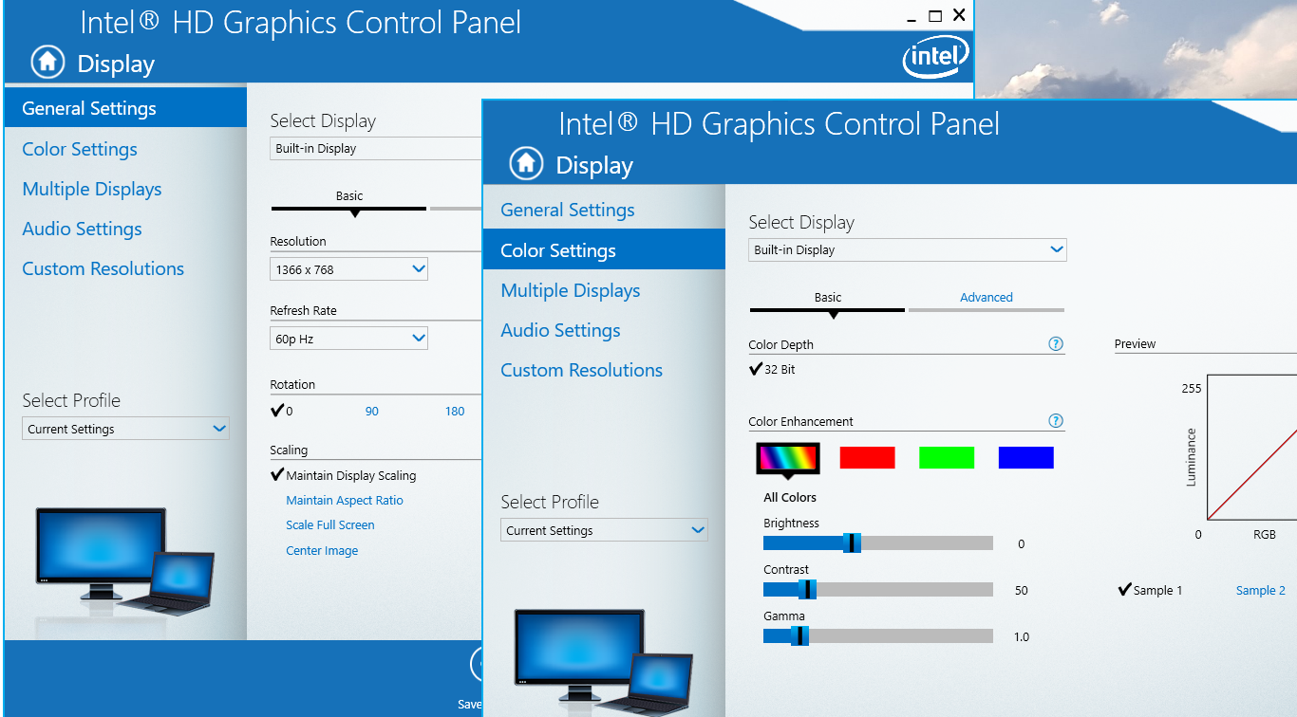
Quality of a CRT Monitor
Computer Graphics, Nepal College of Information Technology, 2009

Slide 9
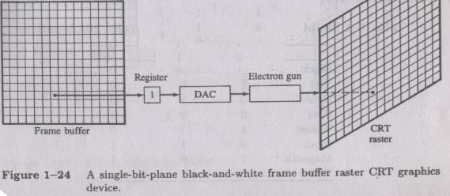
Quality of a CRT Monitor
If on an average it takes 20 nanoseconds to glow a single pixel on the screen and the resolution of the screen is 1024 x 800, will there be a flickering effect seen on the screen?
To glow 1 pixel on screen it takes 20 x 10-9 s
T = To glow all pixels on screen it takes 1024x 800 x 20 x 10-9 s
F = 1 / T = 1 / (1024x 800 x 20 x 10-9)
System Refresh rate = 61 frames per sec
Standard refresh rate = 50 frames per sec
There will be no flickering effect seen on the screen as the refresh rate of the screen is 61 fps which is higher than the standard refresh rate!!!
Consider a raster system with resolution of 640 by 480. How many pixels could be accessed per second in this system by a display controller that refreshes the screen at a rate of 60 frames per second? What is the access time per pixel in this system?
The access time per pixel is 1 / (640x480x60)sec
The access time per pixel is 1 / (1280x1024x60)sec
accurate time (1/60 – 639 x T_{horiz} – T_{vert})/640x480 sec
Computer Graphics, Nepal College of Information Technology, 2009

Slide 10
Quality of a CRT Monitor
Consider a raster system with resolution of 640 by 480. How many pixels could be accessed per second in this system by a display controller that refreshes the screen at a rate of 60 frames per second? What is the access time per pixel in this system?
The access time per pixel is 1 / (640x480x60)sec
The access time per pixel is 1 / (1280x1024x60)sec
Computer Graphics, Nepal College of Information Technology, 2009

Slide 11
Quality of a CRT Monitor
A Raster system can produce a total number of 1024 different levels of intensities from a single pixel of a black and white monitor. If the total resolution of the screen is 640 x 480 what will be the required size of frame buffer for the display purpose?
Computer Graphics, Nepal College of Information Technology, 2009

Slide 12
Quality of a CRT Monitor
How much time is spent scanning across each row of pixels during screen refresh on a raster system with a resolution of 1280 x 1024 and refresh rate of 60 frames per second.
Here time required to refresh the screen (t) = 1/60 seconds
Computer Graphics, Nepal College of Information Technology, 2009

Slide 13
Quality of a CRT Monitor
A Raster system can produce a total number of 1024 different levels of intensities from a single pixel composed of red, green and blue phosphor dots. If the total resolution of the screen is 640 x 480 what will be the required size of frame buffer for the display purpose?
Your mobile phone has a total resolution of 1080x2340 with 409 PPI. What is the display size of your mobile?
Height = 2340/409 in
Width = 1080/409 in
if color depth 24 bit then what is the size of RAM required to display purpose (MB)?
7.3MB
2340
1080
Computer Graphics, Nepal College of Information Technology, 2009

Slide 14
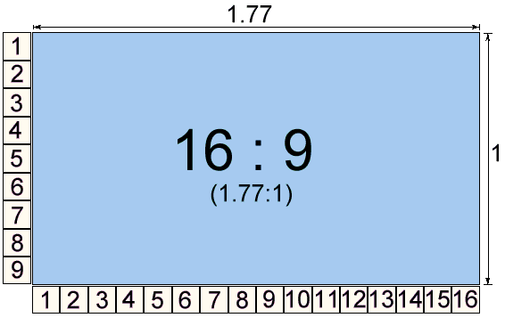
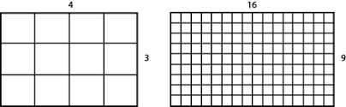
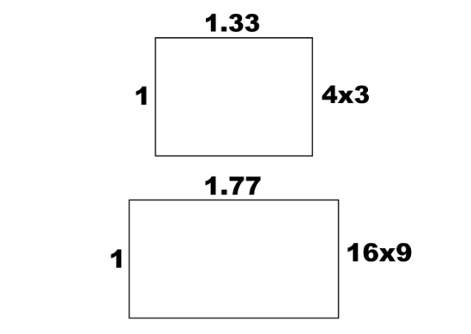
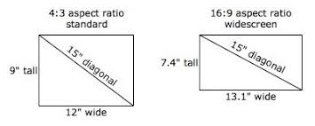
Aspect Ratio
The ratio of vertical points to the horizontal points necessary to produce length of lines in both directions of the screen is called Aspect Ratio.
Usually the aspect ratio is ¾.
Computer Graphics, Nepal College of Information Technology, 2009

Slide 15
Aspect Ratio
Aspect Ratio TVs
4:3 1.33 : 1 Old TV
16:9 1.77 : 1 HDTVs
21:9 2.35 : 1 Theaters
Computer Graphics, Nepal College of Information Technology, 2009

Slide 16
Aspect Ratio
Suppose we have a video monitor with display area that measures 12 inches across and 9.6 inches high. If resolution is 1280 by 1024 what is the aspect ratio and the diameter of each pixel?
Aspect ratio = w/h i.e. 1280/12 / 1024/9.6 = 1
Diameter of each pixel = 12/1280 or 9.6/1024 = 0.0094 inches
Computer Graphics, Nepal College of Information Technology, 2009

Slide 17
Line Drawing
Use DDA Algorithm to digitize a line with end points A(3,1) B(6,3)
m = 2/3 = 0.6
positive slope/slope <1/
left to right
x_{k+1} – x_{k} = 1 x_{k+1} = x_{k}+1
m = y_{k+1} - y_{k} / x_{k+1} – x_{k}
y_{k+1} - y_{k} = m
y_{k+1} = y_{k} + m
starting point(3,1)
x_{k+1} y_{k+1} rounded value y_{k+1}
4 y_{k+1}= 1+0.6=1.6 2
5 y_{k+1} = 1.6+0.6=2.2 2
6 y_{k+1} =2.2 +0.6=2.8 3
9
8
7
6
5
4
3
2
1
0
1
2
3
4
5
6
7
8
9
Computer Graphics, Nepal College of Information Technology, 2009

Slide 18
Line Drawing
Use DDA Algorithm to digitize a line with end points A(10,10) B(12,15)
m = 5/2 = 2.5
Positive slope/slope >1/left to right
y_{k+1} = y_{k}+1
m = y_{k+1} – y_{k}/x_{k+1} – x_{k} m = 1 /x_{k+1} – x_{k}
x_{k+1} = x_{k} + 1/m
starting point(10,10)
X_{k+1} rounded value x_{k+1} y_{k+1} = y_{k}+1
X_{k+1} = 10 + 0.4 = 10.4 10 11
X_{k+1} = 10.4 + 0.4 = 10.8 11 12
X_{k+1} = 10.8 + 0.4 = 11.2 11 13
X_{k+1} = 11.2 + 0.4 = 11.6 12 14
X_{k+1} = 11.6 + 0.4 = 12 12 15
Computer Graphics, Nepal College of Information Technology, 2009

Slide 19
Line Drawing
Use DDA Algorithm to digitize a line with end points A(30,15) B(20,26)
m = 11/-10= -1.1 starting point A(30,15)
negative slope, |slope| > 1 |m| =
Left to Right
x_{k+1} = x_{k} +1/m
x_{k+1} y_{k+1}
x_{k+1} =x_{k} +1/m 16
17
18
19
20
21
22
23
24
25
26
y_{k+1} - y_{k} = 1 y_{k+1} = y_{k} + 1
m = 1 / x_{k+1} - x_{k}
x_{k}
Computer Graphics, Nepal College of Information Technology, 2009

Slide 20
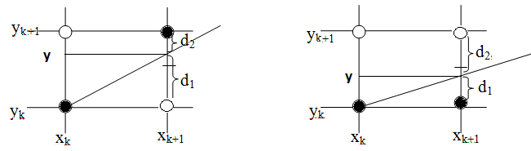
Bresenham’s Line Drawing Algorithm for Lines with Slope <= 1
Equation of line is y = m(x_{k} +1) +c
d₁= ? d₂ = ?
d₁ - d₂ = ?
at kth step P_{k} = Δx (d₁- d₂) = ? …………(1)
at k+1th step P_{k+1} = ? …………(2)
P_{k+1} - P_{k} = ? …………(3)
Two cases:
Case 1: P_{k} <= 0
Case 2: P_{k} > 0

Slide 21
Bresenham’s Line Drawing Algorithm for Lines with Slope <= 1
P₀ = 2Δy - Δx
if P_{k} < 0 (d₁-d₂< 0) then y_{k +1} = y_{k} i.e. we plot the lower pixel (x_{k}+1, y_{k})
P_{k+1}= P_{k} + 2Δy
if P_{k} >= 0 (d₁-d₂> 0) then y_{k +1} = y_{k}+1 i.e. we plot the upper pixel (x_{k}+1, y_{k}+1)
P_{k+1}= P_{k} + 2Δy – 2Δx

Slide 22
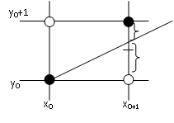
Bresenham’s Line Drawing Algorithm for Lines with Slope <= 1
The Initial Decision Parameter P₀ = ?
We have,
d₁ = y – y_{k} or
d₁ = m (x_{k} + 1) + c – y_{k}
d₂ = y_{k} +1 – y or
d₂ = y_{k} +1 – m (x_{k} + 1) - c
mx₀ + c- y₀ = 0
d₁ – d₂ = 2m (x_{k}+1) + 2c – 2y_{k} – 1
if the line passes thru (x₀, y₀) then
d₁ – d₂ = 2m (x₀+1) + 2c – 2y₀ – 1
= 2mx₀+2m + 2c – 2y₀ – 1
or d₁ – d₂ = 2m– 1 = 2 Δy /Δx -1 Δ since, ?
or P₀ = Δx(d₁ – d₂) = 2 Δy – Δx
d₂
d₁

Slide 23
Bresenham’s Line Drawing Algorithm for Lines with Slope <= 1
The Initial Decision Parameter P₀ = ?
We have,
d₁ – d₂ = 2m (x_{k}+1) + 2c – 2y_{k} – 1
if the line passes thru (x₀, y₀) then
d₁ – d₂ = 2m – 1 + 2mx₀+ 2c – 2y₀
= 2m – 1
or d₁ – d₂ = 2Δy/Δx - 1 since, ?
or P₀ = Δx (d₁ – d₂) = 2Δy - Δx

Slide 24
P₀ = 2Δy - Δx
if P_{k} < 0 (d₁-d₂< 0) then y_{k +1} = y_{k} i.e. we plot the lower pixel (x_{k}+1, y_{k})
P_{k+1}= P_{k} + 2Δy
if P_{k} >= 0 (d₁-d₂> 0) then y_{k +1} = y_{k}+1 i.e. we plot the upper pixel (x_{k}+1, y_{k}+1)
P_{k+1}= P_{k} + 2Δy – 2Δx
Use BLA Algorithm to digitize a line with end points A(10,10) B(14,13)
m = 3/4 starting point(10,10)
positive slope , slope less than 1
P₀ = 2 x 3 – 4= 2 Δy = 3 Δx = 4
since slp is less than 1 x_{k+1} = x_{k} +1 and y_{k+1} = y_{k} +1 or y_{k}
P_{k} x_{k}+1 y_{k}+1
P₀=2 11 11
P₁=2 +6 -8=0 12 12
P₂=0+6 -8=-2 13 12
P₃=-2+6=4 14 13
Computer Graphics, Nepal College of Information Technology, 2009

Slide 25
P₀ = 2Δy - Δx
if P_{k} < 0 (d₁-d₂< 0) then y_{k +1} = y_{k} i.e. we plot the lower pixel (x_{k}+1, y_{k})
P_{k+1}= P_{k} + 2Δy
if P_{k} >= 0 (d₁-d₂> 0) then y_{k +1} = y_{k}+1 i.e. we plot the upper pixel (x_{k}+1, y_{k}+1)
P_{k+1}= P_{k} + 2Δy – 2Δx
Use BLA Algorithm to digitize a line with end points A(20,10) B(30,13)
m = 3/10 starting point(20,10)
positive slope , slope less than 1
P₀ = 6-10= -4 Δy = 3 Δx = 10 2Δy - 2Δx = 6-20= -14
P_{k} x_{k}+1 y_{k}+1
P₀= -4 21 10
P₁= -4+6=2 22 11
P₂= 2-14=-12 23 11
P₃= -12+6=-6 24 11
P₄= -6+6 =0 25 12
P₅= 0-14=-14 26 12
P₆= -14+6=-8 27 12
P₇= -8+6=-2 28 12
P₈= -2+6=4 29 13
P₉= 4-14=-12 30 13
Computer Graphics, Nepal College of Information Technology, 2009

Slide 26
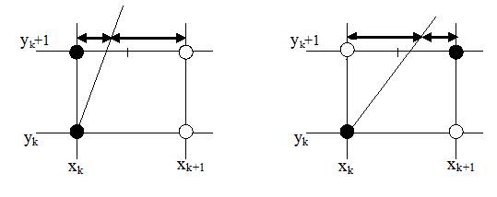
Bresenham’s Line Drawing Algorithm for Lines with Slope >= 1
if d₁ – d₂ > 0 then the pixel at ‘?’ is closer to the line path and ?
y_{k} +1 =mx + c
x = (y_{k} +1 –c)/m
y_{k+1} =y_{k} +1
d₁ = x - x_{k}
d₂ = x_{k}+1 - x
d₁ -d₂ = m
P_{k} =
P_{k+1} =
P_{k+1} =P_{k+ -----------} x_{k+1} = x_{k}+1 or x_{k}
if d₁ – d₂ < 0 then the pixel at ?’ is closer to the line path and ?

Slide 27
Bresenham’s Line Drawing Algorithm for Lines with Slope >= 1
At y_{k} + 1 e.q. of line x = (y_{k} + 1 -c)/m
d₁ = x - x_{k} = (y_{k} + 1 -c)/m - x_{k} d₂ = x_{k} +1 - (y_{k} + 1 -c)/m
d₁ – d₂ = (y_{k} + 1 -c)/m - x_{k} - x_{k} -1 + (y_{k} + 1 -c)/m
Δy(d₁ – d₂) = 2Δx.y_{k} + 2Δx - 2Δxc - 2Δyx_{k} -Δy
P_{k} = Δy (d₁ – d₂) = 2Δx.y_{k} - 2Δyx_{k} + 2Δx - 2Δxc -Δy …. (i)
P_{k} = Δy (d₁ – d₂) = 2Δx.y_{k} - 2Δyx_{k} + b …. (i)
P_{k+1} = 2Δx.y_{k+1} - 2Δyx_{k+1} + b …. (ii)
P_{k+1} = P_{k} + 2Δx.y_{k+1} - 2Δx.y_{k} - 2Δyx_{k+1} + 2Δyx_{k} …. (iiI)
P_{k+1} = P_{k} + 2Δx.(y_{k+1} - y_{k})- 2Δy(x_{k+1} - x_{k}) (iiI)

Slide 28
Bresenham’s Line Drawing Algorithm for Lines with Slope >= 1
P₀ = 2Δx - Δy
P_{k+1} = P_{k} + 2Δx - 2Δy(x_{k+1} - x_{k}) (iiI) since y_{k+1} = y_{k}+ 1
if P_{k} < 0 (d₁-d₂< 0) then x_{k +1} = x_{k} i.e. we plot the left pixel (x_{k}, y_{k}+1)
P_{k+1} = P_{k} + 2Δx
if P_{k} >= 0 (d₁-d₂> 0) then x_{k +1} = x_{k}+1 i.e. we plot the upper pixel (x_{k}+1, y_{k}+1)
P_{k+1} = P_{k} + 2Δx - 2Δy

Slide 29
P₀ = 2Δx - Δy
if P_{k} < 0 (d₁-d₂< 0) then x_{k +1} = x_{k} i.e. we plot the left pixel (x_{k}, y_{k}+1)
P_{k+1} = P_{k} + 2Δx
if P_{k} >= 0 (d₁-d₂> 0) then x_{k +1} = x_{k}+1 i.e. we plot the upper pixel (x_{k}+1, y_{k}+1)
P_{k+1} = P_{k} + 2Δx - 2Δy
Use BLA Algorithm to digitize a line with end points A(10,13) B(14,18)
m =5/4 starting point A(10,13) Δx = 4 Δy= 5
P_{k} x_{k}+1 y_{k}+1
P₀= 8 -5=3 11 14
P₁=3 +8-10= 1 12 15
P₂=1 -2 = -1 12 16
P₃= -1+8=7 13 17
P₄=7+8 -10=5 14 18
The algo runs 18-13=5
Computer Graphics, Nepal College of Information Technology, 2009

Slide 30
Line Drawing
Use BLA Algorithm to digitize a line with end points A(14,13) B(10,10)
m = starting point
positive slope , slope
P_{k} x_{k}+1 y_{k}+1
Computer Graphics, Nepal College of Information Technology, 2009

Slide 31
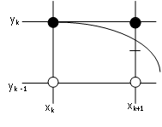
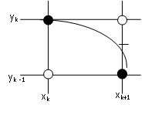
Midpoint Circle Algorithm
(x_{k}+1,y_{k}- 1/2)
At k^{th} Step P_{k} = F_{circle}( x_{k}+1,y_{k}- 1/2 ) = (x_{k}+1)² + (y_{k}- ½)² - r² …….. i
At k+1thStep P_{k+1} = F_{circle}( x_{k+1}+1,y_{k+1}- 1/2 ) = [(x_{k}+1)+1]² + (y_{k+1}- ½)² - r² …….. ii
Now subtracting eq (i) and (ii),
P_{k+1}= P_{k} + 2(x_{k}+1) +1 +(y_{k+1}–½)² - (y_{k}–½)² …….. Iii
Case 1:
If P_{k} < 0 then mid point is inside the circle, so pixel on scanline ‘ y_{k}’ is closer to the circle boundary and y_{k+1} = y_{k}
or P_{k+1}= P_{k} + 2x_{k+1} + 1 …………….. (a) since x_{k+1} = x_{k}+1
Case 2:
If P_{k} > 0 then mid point is outside circle, so pixel on scanline ‘ y_{k}-1’ is closer to the circle boundary and y_{k+1} = y_{k}- 1 From equation (iii)
or P_{k+1}= P_{k} + 2x_{k+1} - 2y_{k+1} +1 .... (b) x_{k+1} = x_{k}+1 y_{k+1} = y_{k}-1

Slide 32
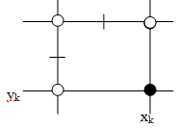
Midpoint Circle Algorithm
Starting point is (r,0) moving in anti clockwise direction

Slide 33
Midpoint Circle Algorithm
(x_{k}-1/2,y_{k}+1)
y_{k}+1
y_{k}+1
x_{k}-1
x_{k}-1
At k^{th} Step P_{k} = F_{circle}(x_{k}-½,y_{k}+1) = (x_{k}-½)² + (y_{k}+1)² - r² …….. i
At k+1thStep P_{k+1} = F_{circle}( x_{k+1}-½,y_{k+1} +1 ) = (x_{k+1} -½)² + [(y_{k}+1) +1]² - r² …….. ii
= (x_{k+1} -½)² + (y_{k}+1)² +2(y_{k}+1)+1 - r² …….. ii
Now subtracting eq (i) and (ii),
P_{k+1}= P_{k} + 2(y_{k}+1) +1 +(x_{k+1}–½)² - (x_{k}–½)² …….. Iii
Case 1:
If P_{k} < 0 then mid point is inside the circle, so pixel on scanline ‘ x_{k}’ is closer to the circle boundary and x_{k+1} = x_{k}
or P_{k+1}= P_{k} + 2y_{k+1} + 1 …………….. (a) since y_{k+1} = y_{k}+1
Case 2:
If P_{k} > 0 then mid point is outside circle, so pixel on scanline ‘ x_{k}-1’ is closer to the circle boundary and x_{k+1} = x_{k}- 1 From equation (iii)
or P_{k+1}= P_{k} + 2y_{k+1} – 2x_{k+1} +1 .... (b) x_{k+1} = x_{k}-1 y_{k+1} = y_{k}-1

Slide 34
Midpoint Circle Algorithm
Digitize a circle with a radius of 9 pixels
Starting Pixel = (0,9)
P₀ = 1 - r=
P_{k} x_{k+1,} y_{k+1}
-8 1,9
-5 2,9
0 3,8
-9 4,8
0 5,7
-3 6,7
10 7,6
9
8
7
6
5
4
3
2
1
0
1
2
3
4
5
6
7
8
9
If P_{k} < 0, the next point along the circle centered on (0,0) is (x_{k+1}, y_{k}) and P_{k+1} = P_{k} + 2x_{k+1} + 1
If P_{k} >= 0, the next point along the circle is (x_{k} + 1, y_{k} - 1) and P_{k+1} = P_{k} + 2x_{k+1}-2y_{k+1}+ 1

Slide 35
Midpoint Circle Algorithm
Digitize a circle with a radius of 9 pixels centered at (5,6)
Starting Pixel = (0,9)
P₀ = 1 - r=
P_{k} x_{k+1,} y_{k+1}
-8 1,9
-5 2,9
0 3,8
-9 4,8
0 5,7
-3 6,7
10 7,6
9
8
7
6
5
x_{k+1,} y_{k+1}
1+5,9+6
2+5,9+6
3+5,8+6
4+5,8+6
5+5,7+6
6+5,7+6
7+5,6+6
4
3
2
1
0
1
2
3
4
5
6
7
8
9
If P_{k} < 0, the next point along the circle centered on (0,0) is (x_{k+1}, y_{k}) and P_{k+1} = P_{k} + 2x_{k+1} + 1
If P_{k} >= 0, the next point along the circle is (x_{k} + 1, y_{k} - 1) and P_{k+1} = P_{k} + 2x_{k+1}-2y_{k+1}+ 1

Slide 36
Midpoint Circle Algorithm
Digitize a circle with the equation (x - 5)² + (y + 6)² = 25
r = 5 circle centered at (5,-6)
Starting Pixel = (0 ,5 )
P₀ = 1 - r=
P_{k}
9
8
7
6
5
4
x_{k+1,} y_{k+1}
3
2
1
0
1
2
3
4
5
6
7
8
9
If P_{k} < 0, the next point along the circle centered on (0,0) is (x_{k+1}, y_{k}) and P_{k+1} = P_{k} + 2x_{k+1} + 1
If P_{k} >= 0, the next point along the circle is (x_{k} + 1, y_{k} - 1) and P_{k+1} = P_{k} + 2x_{k+1}-2y_{k+1}+ 1

Slide 37
Midpoint Circle Algorithm
Digitize a circle with the equation (x - 5)² + (y + 6)² = 25
r = 5 circle centered at (5,-6)
Starting Pixel=(0 ,r) = (0 ,5 )
P₀ = 1 - r=
P_{k}
9
8
7
6
5
4
x_{k+1,} y_{k+1}
3
2
1
0
1
2
3
4
5
6
7
8
9
If P_{k} < 0, the next point along the circle centered on (0,0) is (x_{k+1}, y_{k}) and P_{k+1} = P_{k} + 2x_{k+1} + 1
If P_{k} >= 0, the next point along the circle is (x_{k} + 1, y_{k} - 1) and P_{k+1} = P_{k} + 2x_{k+1}-2y_{k+1}+ 1

Slide 38
Midpoint Circle Algorithm
Digitize a circle with the equation (x - 5)² + (y + 6)² = 25
r = 5 circle centered at (5,-6)
Starting Pixel = (0 ,5 )
P₀ = 1 - r=
P_{k}
9
8
7
6
5
4
x_{k+1,} y_{k+1}
3
2
1
0
1
2
3
4
5
6
7
8
9
If P_{k} < 0, the next point along the circle centered on (0,0) is (x_{k+1}, y_{k}) and P_{k+1} = P_{k} + 2x_{k+1} + 1
If P_{k} >= 0, the next point along the circle is (x_{k} + 1, y_{k} - 1) and P_{k+1} = P_{k} + 2x_{k+1}-2y_{k+1}+ 1

Slide 39
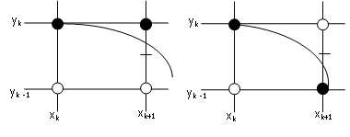
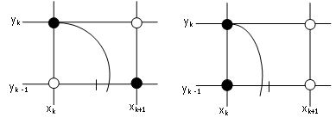
Midpoint Ellipse Algorithm
slope = -1
P1_{k} = F_{ellipse} (x_{k} + 1 , y_{k} - ½ )
= r²_{y} (x_{k} + 1) ² + r²_{x} (y_{k} - ½ ) ² - r²_{x} r²_{y}
P1_{k+1} = F_{ellipse} (x_{k+1} + 1 , y_{k+1} - ½ )
=r²_{y} [(x_{k} + 1)+1] ²+ r²_{x} (y_{k+1} - ½ ) ² - r²_{x} r²_{y}
P1_{k+1} = P1_{k} + …………………..
P1₀ = ?
P2_{k} = F_{ellipse} (x_{k} + ½ , y_{k} - 1)
= r²_{y} (x_{k}+ ½) ² + r²_{x} (y_{k}-1) ²- r²_{x} r²_{y}
P2_{k+1}= F_{ellipse} (x_{k+1} + ½ , y₊₁ - 1)
=r²_{y}(x_{k+1}+1/2)²+r²_{x}[(y -1) – 1]²-r²_{x} r²_{y}
P2_{k+1} = P2_{k} - ……………………
P2₀ = ?

Slide 40
Midpoint Ellipse Algorithm
slope = -1
r²_{y} x² + r²_{x} y² - r²_{x} r²_{y} = 0
The ellipse slope is given by slope = -1
2 r²_{y} x + 2 r²_{x} y dy/dx = 0
dy/dx = - 2 r²_{y} x / 2 r²_{x} y
At the boundary between region 1 and 2 dy/dx = -1
so, 2 r²_{y} x = 2 r²_{x} y
and we move out of the region 1 when
2 r²_{y} x >= 2 r²_{x} y

Slide 41
Midpoint Ellipse Algorithm
slope = -1
P1_{k} = F_{ellipse} (x_{k} + 1 , y_{k} - ½ )
= r²_{y} (x_{k} + 1) ² + r²_{x} (y_{k} - ½ ) ² - r²_{x} r²_{y}
P1_{k+1}=r²_{y} [(x_{k} + 1)+1] ²+ r²_{x} (y_{k+1} - ½ ) ² - r²_{x} r²_{y}
P1_{k+1} = P1_{k} + …………………..
Region 1.
Sample at unit steps in ‘x’ direction, the midpoint is taken between horizontal pixels at each step now. Assuming, (x_{k} ,y_{k}) has been plotted, next pixel to plot is (x_{k+1} , y _{k+1}) where y _{k+1} is
either y _{k} or y _{k} - 1
and x _{k+1} is x _{k} + 1
i.e. choose either (x _{k+1} , y_{k}) or (x_{k+1} , y_{k} - 1)

Slide 42
Midpoint Ellipse Algorithm
slope = -1
P1_{k} = F_{ellipse} (x_{k} + 1 , y_{k} - ½ )
= r²_{y} (x_{k} + 1) ² + r²_{x} (y_{k} - ½ ) ² - r²_{x} r²_{y}
P1_{k+1}=r²_{y} [(x_{k} + 1)+1] ²+ r²_{x} (y_{k+1} - ½ ) ² - r²_{x} r²_{y}
Now subtracting eq (i) and (ii),
P1_{k+1} = P1_{k} + 2r²_{y} (x_{k} + 1) + r²_{y} + r²_{x} [(y_{k+1} - ½ ) ² -(y_{k} - ½ ) ² ] ₋₋₋₋₋₋₋₋₋₋ ( iii )
where y _{k+1} is either y _{k} or y _{k} - 1 depending on the sign of P1_{k}.

Slide 43
Midpoint Ellipse Algorithm
Digitize an Ellipse with r_{y} = 6 pixels and r_{x} = 8 pixels
Starting Pixel = (0,6)
P1₀ = 36 + (0.25 x 64) – 64 x 6 = -332
K P1_{k} x_{k+1,} y_{k+1} 2 r²_{y} x >= 2 r²_{x} y ?
0 P1₀ =-332 1,6 2x36x1=72 >= 2x64x6=768 False
1 P1₁=-224 2,6 2x36x2=144 >= 2x64x6=768 False
2 P1₂=-44 3,6 2x36x3=216 >= 2x64x6=768 False
3 P1₃=208 4,5 2x36x4=288 >= 2x64x5=640 False
4 P1₄=-108 5,5 2x36x5=360 >= 2x64x5=640 False
5 P1₅= 288 6,4 2x36x6=432 >= 2x64x4= 512 False
6 P1₆= 244 7,3 2x36x7=504 >= 2x64x3= 384 True
9
8
7
6
5
4
3
2
1
0
1
2
3
4
5
6
7
8
9
P1₀ = r²_{y} + ¼ r²_{x} - r²_{x} r_{y}
If P1_{k} < 0, the next point along the ellipse centered on (0, 0) is (x_{k+1} , y_{k}) and
P1_{k+1} = P1_{k} + 2r²_{y} x_{k+1} + r²_{y}
Otherwise, the next point along the ellipse is or (x_{k+1} , y_{k} - 1) and with
P1_{k+1} = P1_{k} + 2r²_{y} x_{k+1} - 2r²_{x} y_{k+1} + r²_{y}

Slide 44
Midpoint Ellipse Algorithm
Digitize an Ellipse with r_{y} = 6 pixels and r_{x} = 8 pixels
Starting Pixel (x_{0,} y₀) = (7,3)
P2₀ = -23
K P2_{k} x_{k+1,} y_{k+1}
0 -23 8,2
1 361 8,1
2 297 8,0
9
8
7
6
5
4
3
2
1
0
1
2
3
4
5
6
7
8
9
P2₀ = r²_{y} (x₀ + ½ ) ² + r²_{x} (y₀ - 1) ² - r²_{x} r²_{y}
At each y_{k} position in region 2, starting at k = 0, perform the following test:
If P2_{k} > 0, the next point along the ellipse centered on (0, 0) is (x_{k}, y_{k} - 1) and
P2_{k+1} = P2_{k} - 2r²_{x} y_{k+1} + r²_{x}
Otherwise, the next point along the ellipse is (x_{k} + 1, y_{k} - 1) and
P2_{k+1} = P2_{k} - 2r²_{x} y_{k+1} + r²_{x} + 2r²_{y} x_{k+1}

Slide 45
Midpoint Ellipse Algorithm
Digitize an Ellipse with r_{y} = 8 pixels and r_{x} = 6 pixels
Starting Pixel = (0,8)
P1₀ = -215
K P1_{k} x_{k+1,} y_{k+1} 2 r²_{y} x >= 2 r²_{x} y ?
0 -215 1,8 128>576 False
1 -23 2,8 256>576 False
2 297 3,7 384 > 504 False
3 113 4,6 512 > 432 True
9
8
7
6
5
4
3
2
1
0
1
2
3
4
5
6
7
8
9
P1₀ = r²_{y} + ¼ r²_{x} - r²_{x} r_{y}
If P1_{k} < 0, the next point along the ellipse centered on (0, 0) is (x_{k+1} , y_{k}) and
P1_{k+1} = P1_{k} + 2r²_{y} x_{k+1} + r²_{y}
Otherwise, the next point along the ellipse is or (x_{k+1} , y_{k} - 1) and with
P1_{k+1} = P1_{k} + 2r²_{y} x_{k+1} - 2r²_{x} y_{k+1} + r²_{y}

Slide 46
Midpoint Ellipse Algorithm
Digitize an Ellipse with r_{y} = 8 pixels and r_{x} = 6 pixels
Starting Pixel (x_{0,}y₀)= (4,6)
P2₀ = -108
K P2_{k} x_{k+1,} y_{k+1}
0 -108 5 ,5
1 208 5 ,4
2 -44 6 ,3
3 544 6 ,2
4 436 6,1
5 400 6,0
9
8
7
6
5
4
3
2
1
0
1
2
3
4
5
6
7
8
9
P2₀ = r²_{y} (x₀ + ½ ) ² + r²_{x} (y₀ - 1) ² - r²_{x} r²_{y}
At each y_{k} position in region 2, starting at k = 0, perform the following test:
If P2_{k} > 0, the next point along the ellipse centered on (0, 0) is (x_{k}, y_{k} - 1) and
P2_{k+1} = P2_{k} - 2r²_{x} y_{k+1} + r²_{x}
Otherwise, the next point along the ellipse is (x_{k} + 1, y_{k} - 1) and
P2_{k+1} = P2_{k} - 2r²_{x} y_{k+1} + r²_{x} + 2r²_{y} x_{k+1}

Slide 47
Fixed Point Rotations
A point P(3,2) is required to be shifted down by 2 units, rotated about origin by 45 degrees in anti clock wise direction and scaled by 2 times, what will be the final coordinate of the point after performing these operations?
Composite matrix = S(sx=2,sy=2) . R(theta =45 ccw) .T(tx = 0, ty = - 2)
Composite matrix =
P’ =
P’ =
2 0 0
0 2 0
0 0 1
cos 45 -sin 45 0
sin45 cos45 0
0 0 1
1 0 0
0 1 -2
0 0 1
CM
3
2
1
?
?
1
Computer Graphics, Nepal College of Information Technology, 2009

Slide 48
Fixed Point Rotations
A line with end points A(-5,-1) B(-3-4) need to be reflected about line y = -2, what will be the final coordinates?
Steps:
1. Line y = -2 is translated in y direction along with the line to be reflected so that it is aligned with x axis
2. Take reflection of the line about x axis
3. Line is translated back to its original location along with the reflected line
CM = T(tx = 0, ty = -2) . Rfx . T(tx =0 , ty = 2)
P’ = CM . P
A B
A’ B’
P’ =
Y
5
4
3
2
1
-1
-2
-3
-4
1 0 0
0 1 -2
0 0 1
1 0 0
0 -1 0
0 0 1
1 0 0
0 1 2
0 0 1
-5 -4 -3 -2 -1 0 1 2 x
CM
-5 -3
-1 -4
1 1
1 -1
-1 -4
1 1
Computer Graphics, Nepal College of Information Technology, 2009

Slide 49
Fixed Point Rotations
Y
5
4
3
2
1
-1
-2
-3
-4
-5 -4 -3 -2 -1 0 1 2 x
1 0 0
0 1 2
0 0 1
1 0 0
0 -1 0
0 0 1
1 0 0
0 1 2
0 0 1
Computer Graphics, Nepal College of Information Technology, 2009

Slide 50
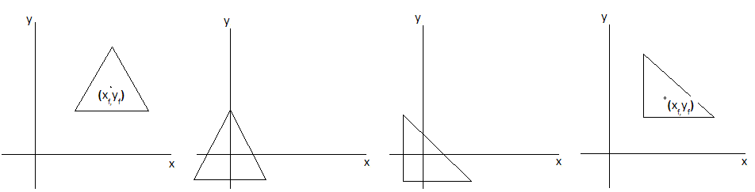
Fixed Point Rotations
1 ₀ xf 0 1 yf
0 0 1
cos 45 -sin 45 0
sin45 cos45 0
0 0 1
1 ₀ -xf 0 1 -yf
0 0 1
CM = T (x_{f,} y_{f}) R T (-x_{f,} -y_{f})
P’ = CM x P
An object is required to be rotated about a fixed point (x_{f,}y_{f})
Steps:
1. The fixed point (x_{f,}y_{f}) along with the the object is translated to origin
2. The object is rotated about origin
3. The fixed point along with the the rotated object is translated back to its
original position (x_{f,}y_{f})
Computer Graphics, Nepal College of Information Technology, 2009

Slide 51
Fixed Point Rotations
An object is required to be rotated about a fixed point (x_{f,}y_{f})
CM = T (x_{f,} y_{f}) R T (-x_{f,} -y_{f})
Composite Matrix (CM) =
P’=
1 0 x_{f}
0 1 t_{f}
0 0 1
cosθ -sinθ 0
sinθ cosθ 0
0 0 1
1 0 -x_{f}
0 1 -y_{f}
0 0 1
CM
x₁ x₂ x₃
y₁ y₂ y₃
1 1 1
Computer Graphics, Nepal College of Information Technology, 2009

Slide 52
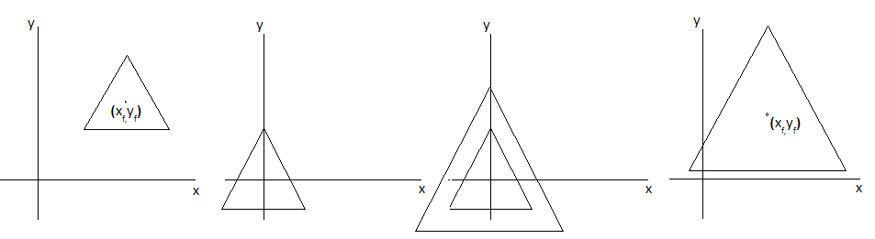
Fixed Point Scaling
An object is required to be scaled about a fixed point (x_{f,}y_{f})
Steps:
1. The fixed point (x_{f,}y_{f}) along with the the object is translated to origin
2. The object is scaled about origin
3. The fixed point along with the the rotated object is translated back to its
original position (x_{f,}y_{f})
s_{x} 0 0 s_{y}
Computer Graphics, Nepal College of Information Technology, 2009

Slide 53
Fixed Point Rotations
An object is required to be scaled about a fixed point (x_{f,}y_{f})
CM = ( T(tx,yf). ( S(sx,sy).T(-xf, -yf) ) )
Composite Matrix (CM) =
P’ =
1 0 x_{f}
0 1 y_{f}
0 0 1
s_{x} 0 0
0 s_{y} 0
0 0 1
1 0 -x_{f}
0 1 -y_{f}
0 0 1
CM
x
y
1
Computer Graphics, Nepal College of Information Technology, 2009

Slide 54
Exercise
Enlarge a triangle A(1,1) B(5,1) C(3,3) about any fixed point P(3,2) by twice its original size sx = 2 sy = 2
CM = T (tx =3,ty =2) S(sx =2, sy = 2) T(tx = -3, ty = -2)
CM =
P’ = = =
1 0 3
0 1 2
0 0 1
2 0 0
0 2 0
0 0 1
1 0 -3
0 1 -2
0 0 1
cm
₁ ₅ ₃
₁ ₁ ₃
₁ ₁ ₁
5
4
3
2
1
-1 0 1 2 3 4 5 6 7
Computer Graphics, Nepal College of Information Technology, 2009

Slide 55
Rotate a triangle A(1,1) B(5,1) C(3,3) about any fixed point P(3,2) by 90 degrees in anti clockwise direction
Steps:
1. Translate the fixed point P(3,2) to origin along with vertices of triangle to be rotated
2. Rotate the triangle by 90 in ccw
3. Translate the fixed point back to its original location along with rotated vertices of triangle
CM = T(tx = 3, ty =2) R T(tx =-3, ty =-2)
CM =
P’ = = =
The final vertices of the triangle after performing the desired transformation are A’(4,0) B’(4,4), C’(2,2)
₁ ₀ ₃
₀ ₁ ₂
₀ ₀ ₁
cos 90 -sin90 0
sin90 cos 90 0
0 0 1
₁ ₀ ₋₃
₀ 1 -2
₀ 0 1
cm
₁ ₅ ₃
₁ ₁ ₃
₁ ₁ ₁
₄ ₄ ₂
₀ ₄ ₂
₁ ₁ ₁
5
4
3
2
1
-1 0 1 2 3 4 5 6 7
Computer Graphics, Nepal College of Information Technology, 2009

Slide 56
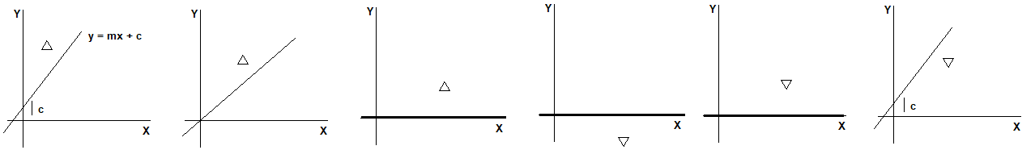
2D Rotations about line y = mx + c
An object is required to be reflected about a line y = mx +c
Steps:
The line is translated so that it passes thru origin
The line is rotated along with the object to be reflected so that the line is aligned with one of the coordinate axes
The object is reflected about that major coordinate axis
The line is rotated back along with the reflected object by the same angle with which it was rotated earlier to align the line with the coordinate axis
The line is translated back along with the reflected object to its original position
Computer Graphics, Nepal College of Information Technology, 2009

Slide 57
Fixed Point Rotations
An object is required to be reflected about a line y = mx +c
CM = T(0,c) . Rccw. Rfx . Rcw . T(0,-c)
cm=
P’ =
1 0 0
0 1 c
0 0 1
cosθ -sinθ 0
sinθ cosθ 0
0 0 1
1 0 0
0 -1 0
0 0 1
cosθ sinθ 0
-sinθ cosθ 0
0 0 1
1 0 0
0 1 -c
0 0 1
CM
x
y
1
Computer Graphics, Nepal College of Information Technology, 2009

Slide 58
Fixed Point Rotations
A Triangle with vertices A(0,4) B(0,5) C(1,5) is required to be reflected about line
y = 2x + 1 CM = T (tx =0 ,ty =1) . Rccw (??) . Rf (??) . Rcw . T(tx =0 ,ty =-1)
y intercept = 1 tan(theta) = 2 theta = tan-1(2) = xxxxx cos(theta)
x y
0 1
1 3
2 5
cm= =
A B C A’ B’ C’
P’ = =
0 0 0
0 1 1
0 0 1
cos(th) -sin(th) 0
sin(th) c0s(th) 0
0 0 1
1 0 0
0 -1 0
0 0 1
Cos(th) sin(th) 0
-sin(th) c0s(th) 0
0 0 1
0 0 0
0 1 -1
0 0 1
CM
0 0 1
4 5 5
1 1 1
Computer Graphics, Nepal College of Information Technology, 2009

Slide 59
Exercise
A Triangle with vertices A(0,4) B(0,5) C(1,5) about line y = 2x + 1
CM=
1 0 0
0 1 1
0 0 1
cosθ -sinθ 0
sinθ cosθ 0
0 0 1
1 0 0
0 -1 0
0 0 1
cosθ sinθ 0
-sinθ cosθ 0
0 0 1
1 0 0
0 1 -1
0 0 1
5
4
3
2
1
3 3 4
2 4 3
1 1 1
-1 0 1 2 3 4 5 6 7
Computer Graphics, Nepal College of Information Technology, 2009

Slide 60
Exercise
A Triangle with vertices A(2,3) B(3,4) C(4,3) about line y = -x + 2
CM=
1 0 0
0 1 2
0 0 1
cosθ -sinθ 0
sinθ cosθ 0
0 0 1
1 0 0
0 -1 0
0 0 1
cosθ sinθ 0
-sinθ cosθ 0
0 0 1
1 0 0
0 1 -2
0 0 1
5
4
3
2
1
-1 0 1 2 3 4 5 6 7
Computer Graphics, Nepal College of Information Technology, 2009

Slide 61
Exercise
A Triangle with vertices A(2,3) B(3,4) C(4,3) is required to be reflected about line y = -3x
Theta = tan-1(-3)
CM=
cosθ -sinθ 0
sinθ cosθ 0
0 0 1
1 0 0
0 -1 0
0 0 1
cosθ sinθ 0
-sinθ cosθ 0
0 0 1
5
4
3
2
1
-1 0 1 2 3 4 5 6 7
Computer Graphics, Nepal College of Information Technology, 2009

Slide 62
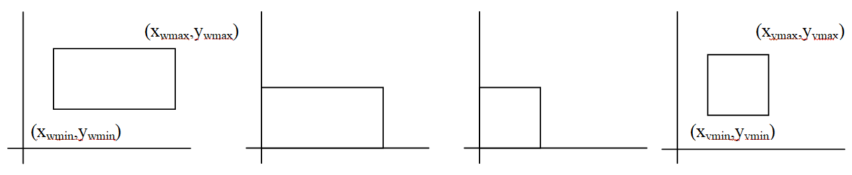
Exercise
A Triangle with vertices A(2,3) B(3,4) C(4,3) in world coordinate space with a window with its lowermost left corner at (10,10) and upper most right corner at (100,100) is required to be mapped to a viewport with its lowermost left corner at (20,20) and upper most right corner at (60,60)
A’B’C’
x_{v} = x_{vmin +} (x_{w –} x_{wmin}) . s_{x} = (12). (4)/(9) = 48/9 =5.--
y_{v=} = y_{vmin +} (y_{w –} y_{wmin}) . s_{y} = (13).(4)/(9) = 52/9 = 5.7
Computer Graphics, Nepal College of Information Technology, 2009

Slide 63
Cohen-Sutherland Line Clipping
Use Cohen Sutherland line clipping algorithm to clip a line
with end point coordinates A(2,7) ,B(8,12) against a
clip window with its lower left corner at (5,5) and
upper right corner at (10,10)
Hints:
Find the region code for each end point of the line
Find if it is above, below, left or right of the clip window
Determine the intersection point of the line segment with the boundary

Slide 64
Cohen-Sutherland Line Clipping
Use Cohen Sutherland line clipping algorithm to clip a line with end point coordinates A(5,20) ,B(60,70)
against a clip window with its lower left corner at (10,10) and upper right corner at (100,100)
Step 1: Establish the region codes for all line end points: TBRL
Region code for A Region code for B
5 < 10 True Bit 1 = 1 Left 60 < 10 False Bit 1 = 0
5 > 100 False Bit 2 = 0 Right 60 > 100 False Bit 2 = 0
20< 10 False Bit 3 = 0 Bottom 70< 10 False Bit 3 = 0
20 > 100False Bit 4 = 0 Top 70> 100 False Bit 4 =0
TBRL
So, Region code for A(0001)
Region code for B(0000)
(100,100)
0000
B(60,70)
A(5,20)
(10,10)

Slide 65
Cohen-Sutherland Line Clipping
Region code for A() Region code for B()
Step 2: Determine which if the line is completely inside the window and or is completely outside:
a. both end points of line DON’T have region codes 0000 so the line is NOT completely inside window false
b. Perform Logial AND operation of region codes of two line end points
Region code for A 0001
Region code for B 0000
AND 0000
Logical AND operation of the region codes of the two end points yields 0000 so it is the case of partial visibility(The line end point A is towards the left side of clip window and the line end point B is inside the clip window)
(100,100)
0000
A’(10,?)
B(60,70)
A(5,20)
(10,10)

Slide 66
Cohen-Sutherland Line Clipping
Use Cohen Sutherland line clipping algorithm to clip a line with end point coordinates A(5,20) ,B(60,70)
against a clip window with its lower left corner at (10,10) and upper right corner at (100,100)
Step 3: Both the tests in step 2 failed so line is not completely inside nor outside . so we need to find out the intersection with the boundaries of the window
slope (m) = (y₂ –y₁)/(x₂-x₁) = 0.91
In case of line end point A(5,20) x₁ = 5 y₁ = 20 TBRL
a. bit 1 is 1 then the line interests with the LEFT boundary
so x = x_{wmin} = 10
y_{i} = y₁ + m * (x – x₁)
y_{i} = 20+ 0.91*5= 24.54
So end point coordinates of line with endpoints A(5,20) ,B(60,70) after clipping : A’(10,25) ,B’(60,70)
(100,100)
0000
B(60,70)
A’(10,25)
A(5,20)
(10,10)
Notes:
y_{i} = 20 + 0.91 * (10 – 5) = 24.5

Slide 67
Cohen-Sutherland Line Clipping
Use Cohen Sutherland line clipping algorithm to clip a line with end point coordinates A(105,30) ,B(55,40)
against a clip window with its lower left corner at (10,10) and upper right corner at (100,100)
Step 1: Establish the region codes for all line end points:
Region code for A Region code for B
105<10 False Bit 1 =0 Left 55< 10 False Bit 1 = 0
105> 100 True Bit 2 =1 Right 55> 100 False Bit 2 = 0
30< 10 False Bit 3 = 0 Bottom 40< 10 False Bit 3 = 0
30> 100 False Bit 4 = 0 Top 40 > 100 False Bit 4 = 0
Region code for A(0010) Region code for B(0000)
bit 2 is 1 then the line interests with the RIGHT boundary
so x = XWMAX = 100
y_{i} = y₁ + m * (x – x₁)
y_{i} =30 + m *(100 -105) = 31
(100,100)
B(55,40)
A’(100,31)
A(105,30)
(10,10)

Slide 68
Cohen-Sutherland Line Clipping
Clip a line with end point coordinates A(-1,6) B(5,-8) against a clip window with its lower left corner at
( -2,-5) and upper right corner at (4,8) using Cohen-Sutherland algorithm.
Step 1: Establish the region codes for all line end points:
Region code for A Region code for B
-1<-2 False Bit 1 = 0 Left 5<-2 False Bit 1 = 0
-1> 4 True Bit 2 = 0 Right 5> 4 False Bit 2 = 1
6< -5 False Bit 3 = 0 Bottom -8< -5 False Bit 3 = 1
6> 8 False Bit 4 = 0 Top -8> 8 False Bit 4 = 0 0101 0100 0110
Region code for A( 0000 ) Region code for B(0110) TBRL
Step 2: Perform Logical AND operation of region codes of line end points yields 0000 partial visibility
bit 2 ,3 and bit is then line interests with right then bottom boundary
Step 3: Find intersection points of the line with window boundaries
so x = x_{wmax} = 4 y = y_{wmin} = -5
y_{i} = y₁ + (x – x₁)*m = -8 + 2.32 = -5.7 x_{i} = 4 + 0.7/-2.33
x_{i} = 4 x_{i} =
5.- -5.6 5.4 -5
0000

Slide 69
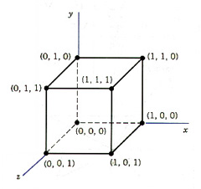
Rotation about an Arbitrary Axis
How will you rotate a unit cube 90º about an axis defined by its endpoints A(2,1,0) and B(3,3,1).
cm = T’_{(x1,y1,z1)} . R’_{X} . R’_{y} . R_{z} . R_{y} . R_{X} . T_{(-x1,-y1,-z1)}

Slide 70
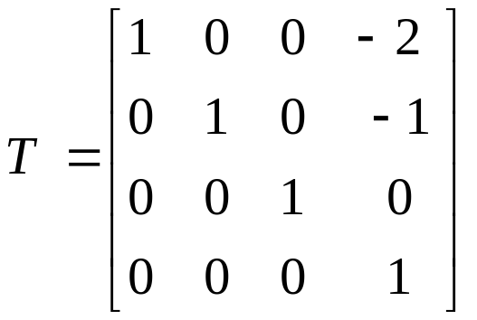
How will you rotate a unit cube 90º about an axis defined by its endpoints A(2,1,0) and B(3,3,1).
Step 1
Translate end point A (2, 1, 0) to the origin
y
(3,3,1)
(1,2,1)
(2,1,0)
(0,0,0)
x
z

Slide 71
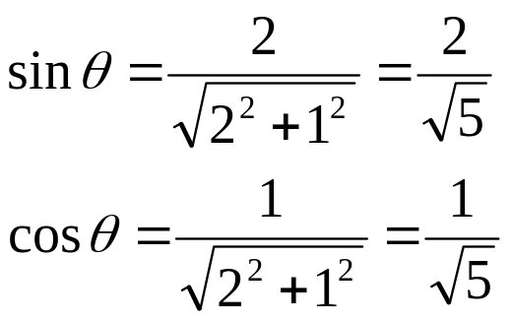
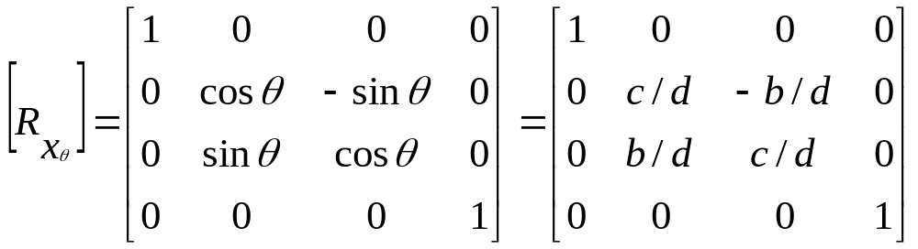
How will you rotate a unit cube 90º about an axis defined by its endpoints A(2,1,0) and B(3,3,1).
Step 2
Rotate the line about x axis in anti clockwise direction by ‘θ’ angle
y
(0,2,1)
(1,2,1)
Projected Point
θ
θ
x
z
Rotated Point

Slide 72

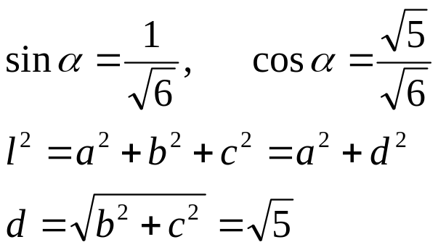

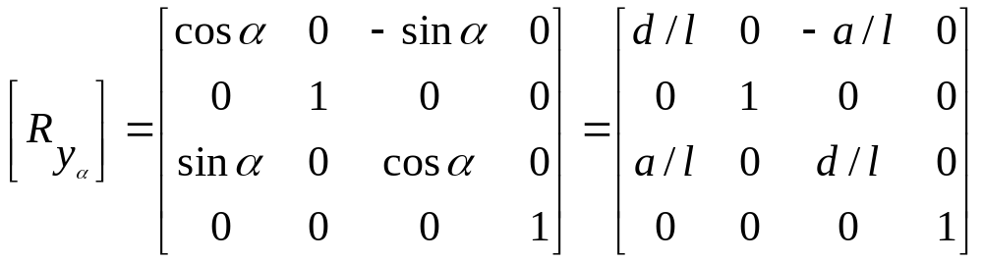

Rotation about an Arbitrary Axis
Step 3
Rotate the line about y axis in clockwise direction by ‘α’ angle
y
Projected Point
d
α
x
Rotated Point
z

Slide 73
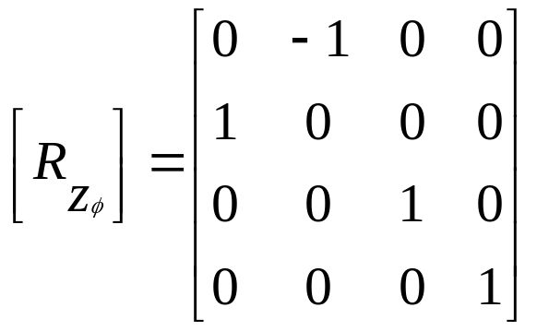
Rotation about an Arbitrary Axis
Step 4
Rotate the object about the line that has been aligned with z axis by the desired angle ‘φ’
y
l
x
θ
z

Slide 74
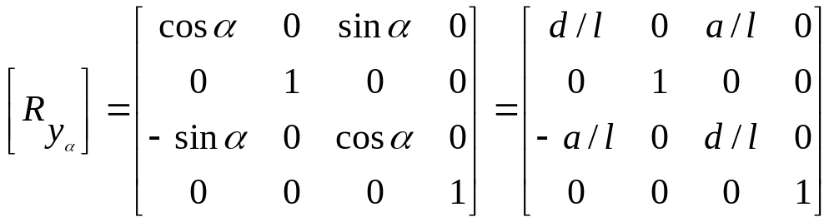
Rotation about an Arbitrary Axis
Step 3
Rotate the line about y axis in clockwise direction by ‘α’ angle
y
Projected Point
d
α
x
Rotated Point
z

Slide 75
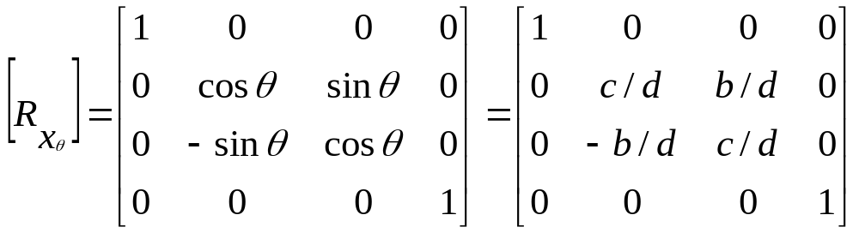
How will you rotate a unit cube 90º about an axis defined by its endpoints A(2,1,0) and B(3,3,1).
Step 2
Rotate the line about x axis in anti clockwise direction by ‘θ’ angle
y
(0,2,1)
(1,2,1)
Projected Point
θ
θ
x
z
Rotated Point

Slide 76
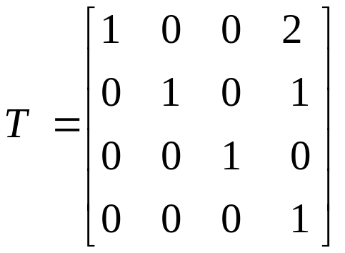
How will you rotate a unit cube 90º about an axis defined by its endpoints A(2,1,0) and B(3,3,1).
Step 1
Translate end point A (2, 1, 0) to the origin
y
(3,3,1)
(1,2,1)
(2,1,0)
(0,0,0)
x
z

Slide 77
Reflection about an Arbitrary Plane
Hints:
Spatial orientation of a plane in 3D space is given by its outward normal
Translate plane so that it passes thru origin
Rotate the Normal two times so that it gets aligned with z axis and the plane lands on xy plane
Take reflection of object about that plane
Perform inverse rotations and translation
z
z
x
x
y
y

Slide 78
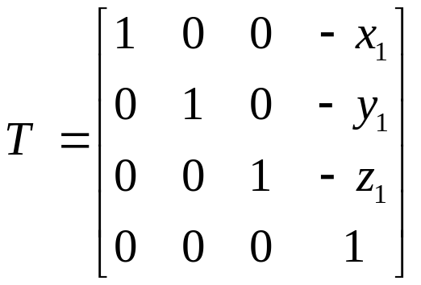
Reflection about an Arbitrary Plane
Step 1
Translate the plane along with the object to be reflected about it so that the plane passes thru origin
z
x
y

Slide 79
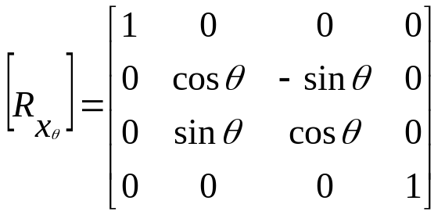
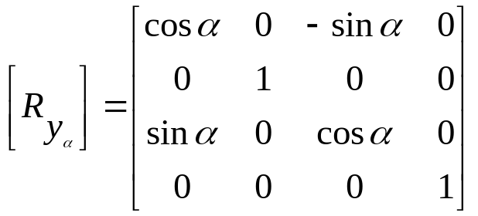
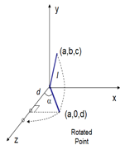
Reflection about an Arbitrary Plane
Step 2
Rotate the normal about x then y axis so that the normal is aligned with z axis and the plane is aligned with xy plane
z
x
y

Slide 80
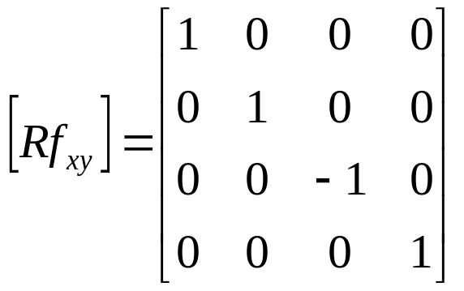
Reflection about an Arbitrary Plane
Step 3
Reflect the object about the xy plane with which the plane has been aligned
z
x
y

Slide 81
Reflection about an Arbitrary Plane
Step 3
Reflect the object about the xy plane with which the plane has been aligned
z
x
y

Slide 82
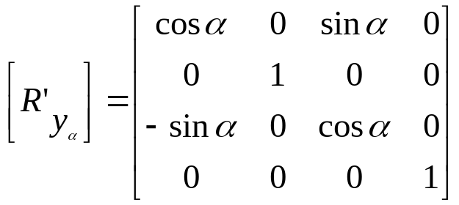
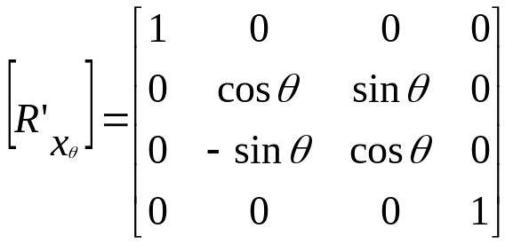
Reflection about an Arbitrary Plane
Step 4
Rotate the normal about y then x axis so that the normal is de-aligned from z axis and the plane is de-aligned with xy plane
z
x
y

Slide 83
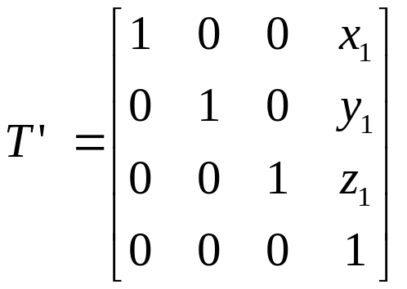
Reflection about an Arbitrary Plane
Step 5
Translate the plane along with the reflected object back to its original location
z
x
y

Slide 84
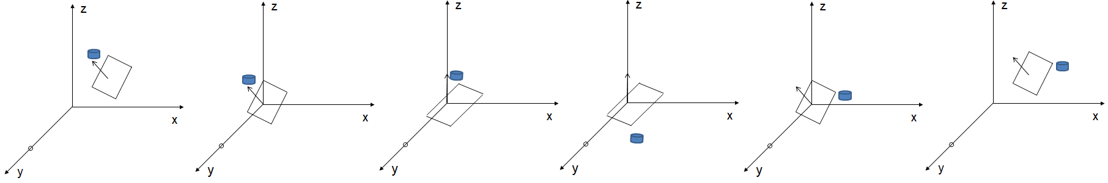
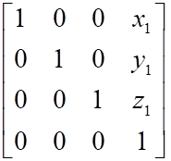
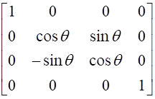
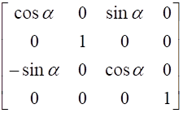
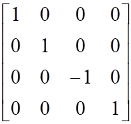
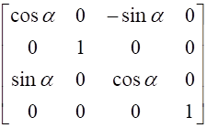
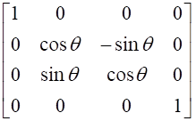
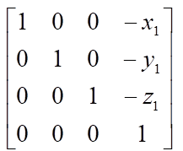
Reflection about an Arbitrary Plane
CM=

Slide 85
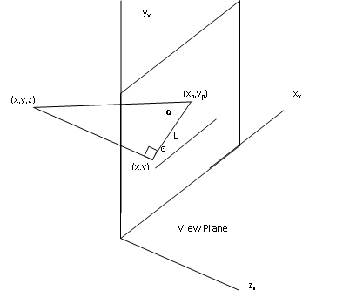
Oblique Parallel Projection
x_{p} = x + Lcosθ
y_{p} = y + Lsinθ
L = z/tan α
= zL₁ L₁ is the inverse of tanα
so the oblique projection equations are
x_{p} = x + z. L₁cosθ
y_{p} = y + z. L₁sinθ
The transformation matrix for producing any parallel projection onto the x_{v} y_{v} plane can be written as
1 0 L₁cosθ 0
0 1 L₁sinθ 0
= 0 0 0 0
0 0 0 1
Orthographic projection is obtained when L₁ = 0
(occurs at projection angle α of 90*)
Oblique projection is obtained with non zero values for L_{1.}
X_{p}
Y_{p}
Z_{p}
1
X
Y
Z
1

Slide 86
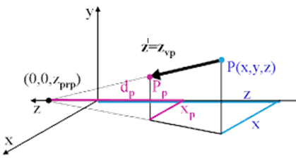

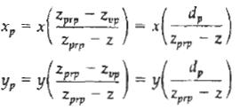
Perspective Projection
Find the perspective projection of a tetrahedron A(3,4,0), B(1,0,4), C(2,0,5), D(4,0,3)onto a projection plane situated at 0. The center of projection should be located at -5.
x’ = x.(zprp -zvp)/(zprp – z)
y’ = y.(zprp -zvp)/(zprp – z)
where, d_{p} = z_{prp} - z_{vp} is the distance of the view plane from the projection reference point.

Slide 87
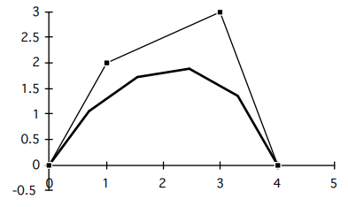
Calculate (x,y) coordinates of Bézier curve described by the following 4 control points: P₀(0,0), P₁(1,2), P₂(3,3), P₃(4,0) with 5 line segments
For four control points, n = 3. = no of control points -1
1. Calculate all the blending functions, BEZ_{j,n} for j = 0, . . ,n using the formula:
BEZ_{j,n} (u) = n! u^{j} (1-u)^{n-j}
j! (n-j)!
BEZ_{0,3} (u) = (1-u)³ = BEZ_{1,3} (u) = 3u (1-u)² =
BEZ_{2,3} (u) = 3u² (1-u) = BEZ_{3,3} (u) = u³ =
2. Calculate the points on the curve.
x(u) = x₀ BEZ_{0,3}(u) + x₁ BEZ_{1,3}(u) + x₂ BEZ_{2,3}(u) + x₃ BEZ_{3,3}(u)
y(u) = y₀ BEZ_{0,3}(u) + y₁ BEZ_{1,3}(u) + y₂ BEZ_{2,3}(u) + y₃ BEZ_{3,3}(u)
u₀ = 0/5 =0 x(0.0) = 0 u₃ =3/5= 0.6 x(0.6)= 1.55
y(0.0) = 0 y(0.6) = 1.7
u₁ = 1/5=0.2 x(0.2) = 0. (1-0.2)³+ 1. 3.0.2 (1-0.2)² + 3. 3.0.2² (1-0.2) + 4.0.2³ = 0.6 0.7
y(0.2) = 0. (1-0.2)³+ 2. 3.0.2 (1-0.2)² + 3. 3.0.2² (1-0.2) + 0.0.2³ = 1.34 = 1.1
u₄ = 4/5=0.8 x(0.8) =
y(0.8) =
u₂ = 2/5=0.4 x(0.4) = u₅ = 5/5=1 x(1) = 4 y(0.4) = y(1) = 0
P₂
P₁
u₃
u₂
u₄
u₁
u₀
u₅
P₀
P₃

Slide 88
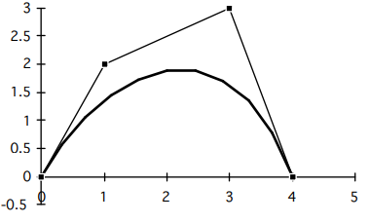
Calculate (x,y) coordinates of Bézier curve described by the following 4 control points: (0,0), (1,2), (3,3), (4,0) with 11 line segments
For four control points, n = 3.
1. Calculate all the blending functions, BEZ_{j,n} for j = 0, . . ,n using the formula:
BEZ_{j,n} (u) = n! u^{j} (1-u)^{n-j}
j! (n-j)!
BEZ_{0,3} (u) = (1-u)³
BEZ_{1,3} (u) = 3u (1-u)²
BEZ_{2,3} (u) = 3u² (1-u)
BEZ_{3,3} (u) = u³
2. Calculate the points on the curve.
u = 0 x(0) = u = x( ) =
y(0) = y( ) =
u = x( ) = u = x( ) =
y( ) = y( ) =
u = x( ) = u = 1 x( 1) =
y( ) = y(1) =

Slide 89
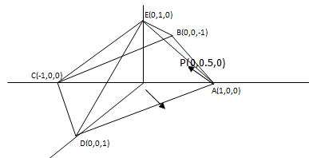
AREA-SUBDIVISION METHODS
Back face culling
Removes faces in the back of an object away from the viewer.
Compute the outward normal to face AED in the rectangular pyramid
The normal is found by the cross product of vectors
AE = -i + j AD = -i + k
n = AE x AD =
= i + j + k
Choosing a point inside the pyramid P(0,0.5,0)
The AP vector is AP = -i + 0.5 j
The dot product of this vector and the normal will indicate the normal orientation:
n. AP = (i + j + k) . (-i + 0.5 j)
= 1 * -1 + 1 * 0.5 = -1 + 0.5 = - 0.5
Since this value is negative the normal is pointing outward hence is a invisible or backface
i j k
-1 1 0
-1 0 1

Slide 90
AREA-SUBDIVISION METHODS
Back face culling
Removes faces in the back of an object away from the viewer.
Compute the outward normal to face AED in the rectangular pyramid
The normal is found by the cross product of vectors
AE = -i + j AD = -i + k
n = AE x AD =
= i + j + k
If the vector V is established from the view point P(5,5,5) to a point in AED such as point A (1,0,0)
Then V = 4i + 5j + 5k
The dot product of n and V is
n.V =(1)(4) +(1)(5) + (1)(5) = 14
since n.V is greater than 0 the face AED is visible.
i j k
-1 1 0
-1 0 1

Slide 91
AREA-SUBDIVISION METHODS
If the vector V is established from the view point P(5,5,5) to a point in AED such as point A (1,0,0)
Then V = 4i + 5j + 5k
The dot product of n and V is
n.V =(1)(4) +(1)(5) + (1)(5) = 14
since n.V is greater than 0 the face AED is visible.

Slide 92
If a person situated at the location P(-1,4,5) is looking at a surface that has vertices A(1,0,0), B(0,0,-1), C(-1,0,0) and D(0,0,1) will the surface be a back face

Slide 93


A rectangle plane has vertices A(0,0), B(8,0), C(8,8), D(0,8), find the reflected intensity at point P(4,4) using Gouraud Shading technique.
The average intensities of reflected illumination at the four vertices are : I_{A} = 6, I_{B} = 8, I_{C} = 3, I_{D} = 5
I4= (-4)/(-8)X 5 + (- 4)/(-8)X6 = 2.5+3= 5.5
D
C
4
A
B

Slide 94


Computer Graphics, Nepal College of Information Technology, 2009

Slide 95
Uses of Computer Graphics
Office automation and electronic publishing
User interfaces
Plotting
Art and commerce
Cartography
Computer aided drafting and design
Scientific and business visualization
Entertainment
Simulation
Computer Graphics, Saroj Shakya, Nepal College of Information Technology, Balkumari

Slide 96
Computer Graphics, Nepal College of Information Technology, 2009

Slide 97
ii. Raster Display Technology
CPU
Peripheral Devices
System Bus
System Memory
Video Controller
Monitor
0 0 0 0 0 0 0 0 0 0 0 1 0 0 0 0 0 0 0 0
0 0 1 0 0 0 0 0 0 0
0 0 0 1 0 0 0 0 0 0
0 0 0 0 1 0 0 0 0 0
Frame Buffer ->
Computer Graphics, Nepal College of Information Technology, 2009

Slide 98

ii. Raster Display Technology
Computer Graphics, Nepal College of Information Technology, 2009

Slide 99

ii. Raster Display Technology
Computer Graphics, Nepal College of Information Technology, 2009

Slide 100

ii. Raster Display Technology
Computer Graphics, Nepal College of Information Technology, 2009

Slide 101
Frame Buffer
Total number of intensities achievable = 2^{n}
out of a single pixel on the screen n = number of
bits assigned to
a single pixel
0 0 0 0 0 0 0 0 0 1 0 1 0 0 0 0 0 0 0 0
0 0 1 0 0 0 0 0 0 0
0 0 0 1 0 0 0 0 0 0
0 0 0 0 1 0 0 0 0 0
0 0 0 0 0 0 0 0 0 1 0 1 0 0 0 0 0 0 0 0
0 0 1 0 0 0 0 0 0 0
0 0 0 1 0 0 0 0 0 0
0 0 0 0 1 0 0 0 0 0
0 0 0 0 0 0 0 0 0 1 0 1 0 0 0 0 0 0 0 0
0 0 1 0 0 0 0 0 0 0
0 0 0 1 0 0 0 0 0 0
0 0 0 0 1 0 0 0 0 0
0 0 0 0 0 0 0 0 0 1 0 1 0 0 0 0 0 0 0 0
0 0 1 0 0 0 0 0 0 0
0 0 0 1 0 0 0 0 0 0
0 0 0 0 1 0 0 0 0 0
0 0 0 0 0 0 0 0 0 1 0 1 0 0 0 0 0 0 0 0
0 0 1 0 0 0 0 0 0 0
0 0 0 1 0 0 0 0 0 0
0 0 0 0 1 0 0 0 0 0
0 0 0 0 0 0 0 0 0 1 0 1 0 0 0 0 0 0 0 0
0 0 1 0 0 0 0 0 0 0
0 0 0 1 0 0 0 0 0 0
0 0 0 0 1 0 0 0 0 0
0 0 0 0 0 0 0 0 0 1 0 1 0 0 0 0 0 0 0 0
0 0 1 0 0 0 0 0 0 0
0 0 0 1 0 0 0 0 0 0
0 0 0 0 1 0 0 0 0 0
1 1 1 1 1 1 1 1
Screen
0 0 0 0 0 0 0 0 0 1 0 1 0 0 0 0 0 0 0 0
0 0 1 0 0 0 0 0 0 0
0 0 0 1 0 0 0 0 0 0
0 0 0 0 1 0 0 0 0 0
0 0 0 0 0 0 0 0 0 1 0 1 0 0 0 0 0 0 0 0
0 0 1 0 0 0 0 0 0 0
0 0 0 1 0 0 0 0 0 0
0 0 0 0 1 0 0 0 0 0
0 0 0 0 0 0 0 0 0 1 0 1 0 0 0 0 0 0 0 0
0 0 1 0 0 0 0 0 0 0
0 0 0 1 0 0 0 0 0 0
0 0 0 0 1 0 0 0 0 0
0 0 0 0 0 0 0 0 0 1 0 1 0 0 0 0 0 0 0 0
0 0 1 0 0 0 0 0 0 0
0 0 0 1 0 0 0 0 0 0
0 0 0 0 1 0 0 0 0 0
Electron
Guns
0 0 0 0 0 0 0 0 0 1 0 1 0 0 0 0 0 0 0 0
0 0 1 0 0 0 0 0 0 0
0 0 0 1 0 0 0 0 0 0
0 0 0 0 1 0 0 0 0 0
0 0 0 0 0 0 0 0 0 1 0 1 0 0 0 0 0 0 0 0
0 0 1 0 0 0 0 0 0 0
0 0 0 1 0 0 0 0 0 0
0 0 0 0 1 0 0 0 0 0
1 1 1 1 1 1 1 1
If n bits are assigned to a single pixel and the resolution of the screen is 1024 x 800 then the total size of the required frame buffer is n x 1024 x 800
Frame Buffer
0 0 0 0 0 0 0 0 0 0 0 1 0 0 0 0 0 0 0 0
0 0 1 0 0 0 0 0 0 0
0 0 0 1 0 0 0 0 0 0
0 0 0 0 1 0 0 0 0 0
0 0 0 0 0 0 0 0 0 1 0 1 0 0 0 0 0 0 0 0
0 0 1 0 0 0 0 0 0 0
0 0 0 1 0 0 0 0 0 0
0 0 0 0 1 0 0 0 0 0
0 0 0 0 0 0 0 0 0 1 0 1 0 0 0 0 0 0 0 0
0 0 1 0 0 0 0 0 0 0
0 0 0 1 0 0 0 0 0 0
0 0 0 0 1 0 0 0 0 0
0 0 0 0 0 0 0 0 0 1 0 1 0 0 0 0 0 0 0 0
0 0 1 0 0 0 0 0 0 0
0 0 0 1 0 0 0 0 0 0
0 0 0 0 1 0 0 0 0 0
0 0 0 0 0 0 0 0 0 1 0 1 0 0 0 0 0 0 0 0
0 0 1 0 0 0 0 0 0 0
0 0 0 1 0 0 0 0 0 0
0 0 0 0 1 0 0 0 0 0
0 0 0 0 0 0 0 0 0 1 0 1 0 0 0 0 0 0 0 0
0 0 1 0 0 0 0 0 0 0
0 0 0 1 0 0 0 0 0 0
0 0 0 0 1 0 0 0 0 0
1 1 1 1 1 1 1 1
Computer Graphics, Nepal College of Information Technology, 2009

Slide 102
Computer Graphics, Nepal College of Information Technology, 2009

Slide 103
Input Hardware
Touch Panels
The touch panel allows the user to point at the screen directly with a finger to move the cursor around the screen or to select the icons.
i. Optical Touch Panel
It uses a series of infrared light emitting diodes (LED) along one vertical edge and along one horizontal edge of the panel
The opposite vertical and horizontal edges contain photo detectors to form a grid of invisible infrared light beams over the display area.
Computer Graphics, Nepal College of Information Technology, 2009

Slide 104

Input Hardware
Touching the screen breaks one or two vertical and horizontal light beams thereby indicating the fingers position
The cursor is then moved to this position or the icon at this position is selected
This is a low resolution panel which offers 10 to 50 positions in each direction
Computer Graphics, Nepal College of Information Technology, 2009

Slide 105
Input Hardware
ii. Sonic Touch Panel
Bursts of high frequency sound waves traveling alternately horizontally and vertically are generated at the edge of the panel .
Touching the screen causes part of each wave to be reflected back to its source
The screen position at the point of contact is then calculated using the time elapsed between when the wave is emitted and when it arrives back at the source
This is a high resolution touch panel having about 500 positions in each direction
Computer Graphics, Nepal College of Information Technology, 2009

Slide 106
Input Hardware
iii. Electrical Touch Panel
It consists of slightly separated two transparent panel one coated with a thin layer of conducting material and the other with resistive material
When the panel is touched with a finger the two plates are forced to touch at the point of contact thereby creating the voltage drop across the resistive plate which is then used to calculate the coordinate of the touched position
The resolution of the touch panel is similar to that of sonic touch panel
Computer Graphics, Nepal College of Information Technology, 2009

Slide 107


Input Hardware
Computer Graphics, Nepal College of Information Technology, 2009

Slide 108
Computer Graphics, Nepal College of Information Technology, 2009

Slide 109
Bresenham’s Line Drawing Algorithm for Lines with Slope >= 1
if d₁ – d₂ > 0 then the pixel at ‘?’ is closer to the line path and ?
y_{k} +1 =mx + c
x = (y_{k} +1 –c)/m
y_{k+1} =y_{k} +1
d₁ = x - x_{k}
d₂ = x_{k}+1 - x
d₁ -d₂ = m
P_{k} =
P_{k+1} =
P_{k+1} =P_{k+ -----------} x_{k+1} = x_{k}+1 or x_{k}
if d₁ – d₂ < 0 then the pixel at ?’ is closer to the line path and ?

Slide 110
Bresenham’s Line Drawing Algorithm for Lines with Slope >= 1
At y_{k} + 1 e.q. of line x = (y_{k} + 1 -c)/m
d₁ = x - x_{k} = (y_{k} + 1 -c)/m - x_{k} d₂ = x_{k} +1 - (y_{k} + 1 -c)/m
d₁ – d₂ = (y_{k} + 1 -c)/m - x_{k} - x_{k} -1 + (y_{k} + 1 -c)/m
Δy(d₁ – d₂) = 2Δx.y_{k} + 2Δx - 2Δxc - 2Δyx_{k} -Δy
P_{k} = Δy (d₁ – d₂) = 2Δx.y_{k} - 2Δyx_{k} + 2Δx - 2Δxc -Δy …. (i)
P_{k} = Δy (d₁ – d₂) = 2Δx.y_{k} - 2Δyx_{k} + b …. (i)
P_{k+1} = 2Δx.y_{k+1} - 2Δyx_{k+1} + b …. (ii)
P_{k+1} = P_{k} + 2Δx.y_{k+1} - 2Δx.y_{k} - 2Δyx_{k+1} + 2Δyx_{k} …. (iiI)
P_{k+1} = P_{k} + 2Δx.(y_{k+1} - y_{k})- 2Δy(x_{k+1} - x_{k}) (iiI)

Slide 111
Bresenham’s Line Drawing Algorithm for Lines with Slope >= 1
P₀ = 2Δx - Δy
P_{k+1} = P_{k} + 2Δx - 2Δy(x_{k+1} - x_{k}) (iiI) since y_{k+1} = y_{k}+ 1
if P_{k} < 0 (d₁-d₂< 0) then x_{k +1} = x_{k} i.e. we plot the left pixel (x_{k}, y_{k}+1)
P_{k+1} = P_{k} + 2Δx
if P_{k} >= 0 (d₁-d₂> 0) then x_{k +1} = x_{k}+1 i.e. we plot the upper pixel (x_{k}+1, y_{k}+1)
P_{k+1} = P_{k} + 2Δx - 2Δy

Slide 112
P₀ = 2Δx - Δy
if P_{k} < 0 (d₁-d₂< 0) then x_{k +1} = x_{k} i.e. we plot the left pixel (x_{k}, y_{k}+1)
P_{k+1} = P_{k} + 2Δx
if P_{k} >= 0 (d₁-d₂> 0) then x_{k +1} = x_{k}+1 i.e. we plot the upper pixel (x_{k}+1, y_{k}+1)
P_{k+1} = P_{k} + 2Δx - 2Δy
Use BLA Algorithm to digitize a line with end points A(10,13) B(14,18)
m =5/4 starting point A(10,13) Δx = 4 Δy= 5
P_{k} x_{k}+1 y_{k}+1
P₀= 8 -5=3 11 14
P₁=3 +8-10= 1 12 15
P₂=1 -2 = -1 12 16
P₃= -1+8=7 13 17
P₄=7+8 -10=5 14 18
The algo runs 18-13=5
Computer Graphics, Nepal College of Information Technology, 2009

Slide 113
Computer Graphics, Nepal College of Information Technology, 2009

Slide 114
Cohen-Sutherland Line Clipping
Use Cohen Sutherland line clipping algorithm to clip a line
with end point coordinates A(0,120) ,B(130,5) against a
clip window with its lower left corner at
A(10,100),B(150,100), C(150,10) and D(10,10)
Hints:
Find the region code for each end point of the line
Find if it is above, below, left or right of the clip window
Determine the intersection point of the line segment with the boundary

Slide 115
Cohen-Sutherland Line Clipping
Use Cohen Sutherland line clipping algorithm to clip a line with end point coordinates A(0,120)
,B(130,5) against a clip window with its lower left corner at A(10,100),B(150,100), C(150,10) and
D(10,10)
Step 1: Establish the region codes for all line end points: TBRL
Region code for A Region code for B
0 < 10 True Bit 1 = 1 Left 130 < 10 False Bit 1 = 0
0 > 150 False Bit 2 = 0 Right 130 > 150 False Bit 2 = 0
120< 10 False Bit 3 = 0 Bottom 5 < 10 False Bit 3 = 1
120 > 100 True Bit 4 = 1 Top 5 > 100 False Bit 4 =0
TBRL
So, Region code for A(1001)
Region code for B(0100)
Step 2: Perform Logical AND operation of region codes
A(0,120)
0000
(150,100)
(10,10)
B(130,5)

Slide 116
Cohen-Sutherland Line Clipping
Clip a line with end point coordinates A(-1,6) B(5,-8) against a clip window with its lower left corner at
( -2,-5) and upper right corner at (4,8) using Cohen-Sutherland algorithm.
Step 3: Find intersection points of the line with window boundaries
y = y_{wmax} = ?
x = x_{wmin} = ?
y_{i} = y₁ + (x – x₁)*m = 120 + (10 -0)*m
The end points of the visible segment of the line AB after performing clipping against the clip window are A’’(10,?) and B’(?,10).
A(0,120)
A’(?,?)
0000
(150,100)
A’’(10,?)
B’(?,10)
(10,10)
B(130,5)

Slide 117
Computer Graphics, Nepal College of Information Technology, 2009

Slide 118
Midpoint Circle Algorithm
Digitize a circle with a radius of 10 pixels
Starting Pixel = (0,10)
P₀ = 1 - r= -9
P_{k} x_{k+1 ,} y_{k+1}
P₀ = -9 1 , 10
P₁ = -9+2+1=-6 2 , 10
P₂ = -6 +4+1=-1 3 , 10
P₃ = -1 +6+1= 6 4 , 9
P₄ =6+8-18+1=-3 5 , 9
P₅ =-3+10+1= 8 6 , 8
P₆ =8+12-16+1=5 7 , 7
10
9
8
7
6
5
4
3
2
1
0
1
2
3
4
5
6
7
8
9
If P_{k} < 0, the next point along the circle centered on (0,0) is (x_{k+1}, y_{k}) and P_{k+1} = P_{k} + 2x_{k+1} + 1
If P_{k} >= 0, the next point along the circle is (x_{k} + 1, y_{k} - 1) and P_{k+1} = P_{k} + 2x_{k+1}-2y_{k+1}+ 1

Slide 119
Computer Graphics, Nepal College of Information Technology, 2009

Slide 120
Computer Graphics, Nepal College of Information Technology, 2009

Slide 121


Window to Viewport Transformation
For displaying one has to convert world coordinates into screen coordinates
This transformation is called viewing transformation
A point in position(x_{w},y_{w}) in window is mapped into position (x_{v,} y_{v}) in the viewport
To maintain same relative placement in view port as in window we require,
Window Viewport
Viewport
Computer Graphics, Nepal College of Information Technology, 2009

Slide 122

Window to Viewport Transformation

Slide 123
Window to Viewport Transformation (Matrix Form)
Window to View port Transformation (Viewing Transformation)
To transform a window to the view port we have to perform the following steps:
Step1: The object together with its window is translated until the lower left corner of the window is at the origin
Step2: The object and window are scaled until the window has the dimensions of the view port
Step3: Again translate to move the view port to its correct position on the screen
The overall transformation which performs these three steps called the viewing transformation. Let the window coordinates be (x_{wmin}, y_{wmin})and (x_{wmax}, y_{wmax}), view port coordinates be (x_{vmin}, y_{vmin})and (x_{vmax}, y_{vmax})
Computer Graphics, Nepal College of Information Technology, 2009

Slide 124




Window to Viewport Transformation (Viewing Transformation)
Therefore the viewing transformation is as follows:
We have to translate the window to the origin by
T_{x} = -x_{wmin} and T_{y} = -y_{wmin}
Then scale the window such that its size is matched to the view port using
S_{x} =(x_{vmax} - x_{vmin})/(x_{wmax} - x_{wmin}) S_{y} =(y_{vmax} - y_{vmin})/(y_{wmax} - y_{wmin})
3. Again translate it by T_{x} = x_{vmin} and T_{y} = y_{vmin}
All these steps can be represented by the following composite transformation:
CM = T_{v} * S_{wv} * T_{w}
Computer Graphics, Nepal College of Information Technology, 2009

Slide 125
Window to Viewport Transformation (Viewing Transformation)
All these steps can be represented by the following composite transformation:
CM = T_{v} * S_{wv} * T_{w}
CM =
Here scaling factors are S_{x} =(x_{vmax} - x_{vmin})/(x_{wmax} - x_{wmin}) S_{y} =(y_{vmax} - y_{vmin})/(y_{wmax} - y_{wmin})
=
1 0 x_{wmin}
0 1 y_{wmin}
0 0 1
s_{x} 0 0
0 s_{y} 0
0 0 1
1 0 -x_{wmin}
0 1 -y_{wmin}
0 0 1
x_{v}
y_{v}
1
_{CM}
x_{w}
y_{w}
1
Computer Graphics, Nepal College of Information Technology, 2009

Slide 126
Exercise
A Triangle with vertices A(2,3) B(3,4) C(4,3) in world coordinate space with a window with its lowermost left corner at (10,10) and upper most right corner at (100,100) is required to be mapped to a viewport with its lowermost left corner at (20,20) and upper most right corner at (60,60)
A’B’C’
x_{v}= x_{vmin +} (x_{w –} x_{wmin}) . s_{x} = 60 + (2 -10)*(60-20)/(100 -10)=?
y_{v}= y_{vmin +} (y_{w –} y_{wmin}) . s_{y} =
Computer Graphics, Nepal College of Information Technology, 2009

Slide 127
Computer Graphics, Nepal College of Information Technology, 2009

Slide 128
Reduce the size of a triangle A(0,0) B(1,1) C(5,2) about any fixed point P(1,1) by half its original size sx = 1/2 sy = 1/2
Steps:
1.
2.
3.
Composite Matrix (CM) = T (tx = 1, ty =1 )S(sx = 1/2, sy = 1/2) T(tx = -1 , ty = -1)
CM =
P’ = =
The final coordinates of the triangle after reducing its size by half its original size are A’( ) B’( ) C’( ).
1 0 1
0 1 1
0 0 1
1/2 0 0
0 1/2 0
0 0 1
1 0 -1
0 1 -1
0 0 1
cm
₀ ₁ ₅
₀ ₁ ₂
₁ ₁ ₁
Computer Graphics, Nepal College of Information Technology, 2009

Slide 129
Computer Graphics, Nepal College of Information Technology, 2009

Slide 130




Projections
Parallel
Coordinate positions are transformed to the view plane along parallel
lines
Preserves relative proportions of objects so that accurate views of various sides of an object are obtained but doesn’t give realistic representation of the 3D object.
Can be used for exact measurements so parallel lines remain parallel.

Slide 131

Orthographic Parallel Projection
Projection is perpendicular to view plane
Used to produce the front, side and top views of an object. Front, side and rear orthographic projections of an object are called elevations
Views that display more than one face of an object are
called axonometric orthographic projections.
Transformation Equations
If view plane is placed at position z_{vp} along z_{v} axis
then any point (x,y,z) is transformed to projection as
x’ = x , y’ = y z’ = 0
z value is preserved for depth information needed (visible surface detection).
1 0 0 0 x
0 1 0 0 y
= 0 0 0 0 z
0 0 0 1 1
x’
y’
Z’
1

Slide 132

Oblique Parallel Projection
Obtained by projecting points along parallel lines that are not perpendicular to projection plane.
Often specified with two angles θ and α
Point (x ,y ,z) is projected to position(x_{p} , y_{p} ) on the view plane
Orthographic projection coordinates on the plane are (x,y).
Oblique projection line from (x,y,z) to (x_{p} , y_{p} ) makes an angle α with the line on the projection plane that joins (x_{p} , y_{p} ) and (x , y)
This line of length L is at an angle θ with the horizontal direction in the projection plane.
Expressing projection coordinates in terms of x,y,L and θ as
cosθ = (x_{p} - x)/ L x_{p} = x + Lcosθ
sinθ = (y_{p} - y)/ L y_{p} = y + Lsinθ
L depends on the angle α and z coordinate of point to
be projected
tan α = z/L
Oblique
Ortho

Slide 133
Oblique Parallel Projection
x_{p} = x + Lcosθ
y_{p} = y + Lsinθ
L = z/tan α
= zL₁ L₁ is the inverse of tanα
so the oblique projection equations are
x_{p} = x + z. L₁cosθ
y_{p} = y + z. L₁sinθ
The transformation matrix for producing any parallel projection onto the x_{v} y_{v} plane can be written as
1 0 L₁cosθ 0
0 1 L₁sinθ 0
= 0 0 0 0
0 0 0 1
Orthographic projection is obtained when L₁ = 0
(occurs at projection angle α of 90*)
Oblique projection is obtained with non zero values for L_{1.}
X_{p}
Y_{p}
Z_{p}
1
X
Y
Z
1

Slide 134


Perspective Projection

Slide 135

Perspective Projection
Lines appear to converge to a distant point in the background, distant objects appear smaller than objects closer to the viewing position.
To obtain a perspective projection of a three-dimensional object, transform points along projection lines that meet at the projection reference point.
Suppose the perspective reference point is set at position z_{prp} along the z_{v}, axis, and the view plane is placed at z_{vp} .
Equations describing coordinate positions along this perspective projection line in parametric form as

Slide 136

Perspective Projection
Parameter ‘u’ takes values from 0 to 1, and coordinate position (x', y', z') represents any point along the projection line.
When u = 0, we are at position P = (x, y, z)
At the other end of the line, u = 1 and we have the projection reference point coordinates (0,0, z_{prp}) On the view plane, z' = z_{vp} , and we can solve the z' equation for parameter u at this position along the projection line:
Substituting this value of u into the equations for x' and y', we obtain the perspective transformation equations
z’ - z = -(z - zprp)u u =(zvp - z)/(zprp-z)
x’ = x – xu = x – x.zvp + xz/(zprp-z)
= (x.zprp - xz – x.zvp + xz )/(zprp-z)
x’ = x (zprp – zvp)/(zprp - z)
y’ = y (zprp – zvp)/(zprp - z)

Slide 137

Computer Graphics, Nepal College of Information Technology, 2009

Slide 138
Hidden Surface Removal (Visible Surface Detection)
Object Space Methods ( OSM )
- Back Face Detection method
Image Space Method ( ISM )
Z Buffer
A Buffer
Scanline
Hybrid (Image/Object)
- Depth Sorting
Area Subdivision Method

Slide 139

Backface Detection
V , a view vector is constructed from any point on the surface to the viewpoint, the dot product of this vector and the normal n, indicates visible faces as follows:
If v.n > 0 the face is visible else face is hidden
I vector directed to a point inside object
n
n
v

Slide 140




Backface Detection

Slide 141

Z-buffer or Depth buffer Method:
Commonly used ISM
Since object depth is usually measured from the view plane along the z axis of a viewing surface, each surface of a scene is processed separately , one point at a time across the surface
Usually for polygon surface, because depth values can be computed very quickly and the method is easy to implement and can apply to non planar surfaces.
Implementing the algorithm in normalized coordinates , z value ranges from 0 at the back clipping plane to z_{max} at the front clipping plane.
R G B

Slide 142
Z-buffer or Depth buffer Method:
Algorithm:
Initialize the depth buffer and refresh buffer so that for all buffer
position (x,y)
depth(x,y) = 0 or (zmin) and refresh(x,y) = Ibackground
ii. For each position on each polygon surface compare depth values to
previously stored values in the depth buffer to determine visibility
Calculate the depth ‘z’ for each (x,y) position on the polygon
iii. If z > depth(x,y) then set
depth = z and refresh(x,y) = Isurface (x,y)
where Ibackground (x,y) is background intensity , Isurface (x,y) is projected intensity value for surface at pixel position (x,y)

Slide 143
Computer Graphics, Nepal College of Information Technology, 2009

Slide 144


Slide 145


Slide 146

B. Gouraud Shading
Intensity interpolation scheme developed by Gouraud Renders a polygon surface by linearly interpolating intensity values across the surface
Intensity values for each polygon are matched with the values of the adjacent polygon along the common edge thus eliminating the intensity discontinuities occur in “flat shading”

Slide 147

Calculation for each polygon surfaces
- Determine the average unit normal vector at each polygon vertex.
- Apply an illumination model to each vertex to calculate the vertex intensity
- Linearly interpolate the vertex intensities over the surface of the polygon
N₁ normal to ABCD plane , N₂ normal to CDEF plane and so on .

Slide 148

For any vertex position V normal unit vector once N_{v} is known intensity at vertices can be obtained from lighting model

Slide 149

Next step:
Interpolating intensities along polygon edges
Fast method to find intensity at 4 using 1 and 2 using only vertical displacement
I₄ = y₄ - y₂ . I₁ + y₁ - y₄ . I₂ y₁ - y₂ y₁ - y₂
Similar process for I₅, using 3 and 2

Slide 150


For interior point ‘p’ interpolated from the bounding intensities at point 4 & 5
I_{p} = x₅ - x_{p} . I₄ + x_{p} - x₄ . I₅ x₅ - x₄ x₅ - x₄
Easier than this is incremental calculations for successive edge intensity values
I = y - y₂ . I₁ + y₁ - y . I₂ y₁ - y₂ y₁ - y₂ for next scan line y - 1
I’ = I + I₂ – I₁ y₁ - y₂

Slide 151
Advantages:
- Removes discontinuities of intensity at the edge compared to constant shading model
Disadvantages:
- Highlights on the surface are sometimes displayed with anomalous shapes and linear intensity
- Interpolation can cause bright or dark intensity streaks called Mach Bands to appear on the surfaces.
Mach bands can be reduced by
- dividing surface into a greater number of polygon faces
- Use Phong shading (requires more calculation)

Slide 152



Slide 153
C. Phong Shading
More accurate method for rendering a polygon surface is to interpolate normal vector and then apply the illumination model to each surface point called “Phong Shading” or “Normal Vector Interpolation Shading”.
It displays more realistic highlights on a surface
Greatly reduces Mach band effect.

Slide 154
Steps:
- Determine the average unit vector normal at each polygon vertex
- Linearly interpolate the vertex normal over polygon surface
- Apply an illumination model along each scan line to calculate projected pixel intensities for the surface points

Slide 155

N can be obtained by vertically interpolating between edge end point normal (N₁ and N₂)
N = y - y₂ . N₁ + y₁ - y . N₂ y₁ - y₂ y₁ - y₂

Slide 156
Incremental methods are used to evaluate normal between scan lines and along each individual scan line (as in Gouraud) at each pixel position along a scan line the illumination model is applied to determine the surface intensity at that point
Produces accurate results than the direct interpolation but it requires considerable more calculations

Slide 157
2019
Computer Graphics, Nepal College of Information Technology, 2009

Slide 158

Computer Graphics, Nepal College of Information Technology, 2009

Slide 159
Uses of Computer Graphics
Office automation and electronic publishing
User interfaces
Plotting
Art and commerce
Cartography
Computer aided drafting and design
Scientific and business visualization
Entertainment
Simulation
Computer Graphics, Saroj Shakya, Nepal College of Information Technology, Balkumari

Slide 160
Computer Graphics, Nepal College of Information Technology, 2009

Slide 161
What is the fraction of total refresh time spent in retrace of electron beam for a non interlaced raster system with a resolution of 1280 x 1024 and refresh rate of 60 Hz , the horizontal retrace time is 5 microsecond and vertical retrace time of 500 microsecond?
Here ,
The fraction of total refresh time = n x t_{h} + t_{v}
spent in retrace of electron beam 1/r
where t_{h} is horizontal retrace
t_{v} is vertical retrace and r is the refresh rate
n x m = ‘m’ scan lines and ‘n’ pixels in each scan line
Computer Graphics, Nepal College of Information Technology, 2009

Slide 162
Computer Graphics, Nepal College of Information Technology, 2009

Slide 163
ii. Raster Display Technology
CPU
Peripheral Devices
System Bus
System Memory
Video Controller
Monitor
0 0 0 0 0 0 0 0 0 0 0 1 0 0 0 0 0 0 0 0
0 0 1 0 0 0 0 0 0 0
0 0 0 1 0 0 0 0 0 0
0 0 0 0 1 0 0 0 0 0
Frame Buffer ->
Computer Graphics, Nepal College of Information Technology, 2009

Slide 164
ii. Raster Display Technology
Computer Graphics, Nepal College of Information Technology, 2009

Slide 165
ii. Raster Display Technology
Computer Graphics, Nepal College of Information Technology, 2009

Slide 166
ii. Raster Display Technology
Computer Graphics, Nepal College of Information Technology, 2009

Slide 167
Frame Buffer
Total number of intensities achievable = 2^{n}
out of a single pixel on the screen n = number of
bits assigned to
a single pixel
0 0 0 0 0 0 0 0 0 1 0 1 0 0 0 0 0 0 0 0
0 0 1 0 0 0 0 0 0 0
0 0 0 1 0 0 0 0 0 0
0 0 0 0 1 0 0 0 0 0
0 0 0 0 0 0 0 0 0 1 0 1 0 0 0 0 0 0 0 0
0 0 1 0 0 0 0 0 0 0
0 0 0 1 0 0 0 0 0 0
0 0 0 0 1 0 0 0 0 0
0 0 0 0 0 0 0 0 0 1 0 1 0 0 0 0 0 0 0 0
0 0 1 0 0 0 0 0 0 0
0 0 0 1 0 0 0 0 0 0
0 0 0 0 1 0 0 0 0 0
0 0 0 0 0 0 0 0 0 1 0 1 0 0 0 0 0 0 0 0
0 0 1 0 0 0 0 0 0 0
0 0 0 1 0 0 0 0 0 0
0 0 0 0 1 0 0 0 0 0
0 0 0 0 0 0 0 0 0 1 0 1 0 0 0 0 0 0 0 0
0 0 1 0 0 0 0 0 0 0
0 0 0 1 0 0 0 0 0 0
0 0 0 0 1 0 0 0 0 0
0 0 0 0 0 0 0 0 0 1 0 1 0 0 0 0 0 0 0 0
0 0 1 0 0 0 0 0 0 0
0 0 0 1 0 0 0 0 0 0
0 0 0 0 1 0 0 0 0 0
0 0 0 0 0 0 0 0 0 1 0 1 0 0 0 0 0 0 0 0
0 0 1 0 0 0 0 0 0 0
0 0 0 1 0 0 0 0 0 0
0 0 0 0 1 0 0 0 0 0
1 1 1 1 1 1 1 1
Screen
0 0 0 0 0 0 0 0 0 1 0 1 0 0 0 0 0 0 0 0
0 0 1 0 0 0 0 0 0 0
0 0 0 1 0 0 0 0 0 0
0 0 0 0 1 0 0 0 0 0
0 0 0 0 0 0 0 0 0 1 0 1 0 0 0 0 0 0 0 0
0 0 1 0 0 0 0 0 0 0
0 0 0 1 0 0 0 0 0 0
0 0 0 0 1 0 0 0 0 0
0 0 0 0 0 0 0 0 0 1 0 1 0 0 0 0 0 0 0 0
0 0 1 0 0 0 0 0 0 0
0 0 0 1 0 0 0 0 0 0
0 0 0 0 1 0 0 0 0 0
0 0 0 0 0 0 0 0 0 1 0 1 0 0 0 0 0 0 0 0
0 0 1 0 0 0 0 0 0 0
0 0 0 1 0 0 0 0 0 0
0 0 0 0 1 0 0 0 0 0
Electron
Guns
0 0 0 0 0 0 0 0 0 1 0 1 0 0 0 0 0 0 0 0
0 0 1 0 0 0 0 0 0 0
0 0 0 1 0 0 0 0 0 0
0 0 0 0 1 0 0 0 0 0
0 0 0 0 0 0 0 0 0 1 0 1 0 0 0 0 0 0 0 0
0 0 1 0 0 0 0 0 0 0
0 0 0 1 0 0 0 0 0 0
0 0 0 0 1 0 0 0 0 0
1 1 1 1 1 1 1 1
If n bits are assigned to a single pixel and the resolution of the screen is 1024 x 800 then the total size of the required frame buffer is n x 1024 x 800
Frame Buffer
0 0 0 0 0 0 0 0 0 0 0 1 0 0 0 0 0 0 0 0
0 0 1 0 0 0 0 0 0 0
0 0 0 1 0 0 0 0 0 0
0 0 0 0 1 0 0 0 0 0
0 0 0 0 0 0 0 0 0 1 0 1 0 0 0 0 0 0 0 0
0 0 1 0 0 0 0 0 0 0
0 0 0 1 0 0 0 0 0 0
0 0 0 0 1 0 0 0 0 0
0 0 0 0 0 0 0 0 0 1 0 1 0 0 0 0 0 0 0 0
0 0 1 0 0 0 0 0 0 0
0 0 0 1 0 0 0 0 0 0
0 0 0 0 1 0 0 0 0 0
0 0 0 0 0 0 0 0 0 1 0 1 0 0 0 0 0 0 0 0
0 0 1 0 0 0 0 0 0 0
0 0 0 1 0 0 0 0 0 0
0 0 0 0 1 0 0 0 0 0
0 0 0 0 0 0 0 0 0 1 0 1 0 0 0 0 0 0 0 0
0 0 1 0 0 0 0 0 0 0
0 0 0 1 0 0 0 0 0 0
0 0 0 0 1 0 0 0 0 0
0 0 0 0 0 0 0 0 0 1 0 1 0 0 0 0 0 0 0 0
0 0 1 0 0 0 0 0 0 0
0 0 0 1 0 0 0 0 0 0
0 0 0 0 1 0 0 0 0 0
1 1 1 1 1 1 1 1
Computer Graphics, Nepal College of Information Technology, 2009

Slide 168

Display Devices
i. Beam Penetration Method:
Two different layers of phosphor coating used Red (outer) and Green
(inner)
Display of color depends on the depth of penetration of the electron beam
into the phosphor layers
A beam of slow electrons excites only the outer red layer
A beam of very fast electrons penetrates thru the red phosphor and excites
the inner green layer
When quantity of red is more than green then color appears as orange
When quantity of green is more than red then color appears as yellow
Screen color is controlled by the beam acceleration voltage.
Only four colors possible, poor picture quality
Computer Graphics, Nepal College of Information Technology, 2009

Slide 169
Display Devices
ii. Shadow Mask Method
The inner side of the viewing surface of a color CRT consists of closely spaced groups of red, green and blue phosphor dots.
Each group is called a triad
A thin metal plate perforated with many small holes is mounted close to the inner side of the viewing surface. This plate is called shadow mask
The shadow mask is mounted in such a way that each hole is correctly aligned with a triad in color CRT
Computer Graphics, Nepal College of Information Technology, 2009

Slide 170

Display Devices
There are three electron guns one for each dot in a triad
The electron beam form each gun therefore hits only the corresponding dot of a triad as the three electron beams deflect
A triad is so small that light emanating from the individual dots is perceived by the viewer as a mixture of the three colors
Thus, a wide range of colors can be produced by each triad depending on how strongly each individual phosphor dot in a triad is excited.
Computer Graphics, Nepal College of Information Technology, 2009

Slide 171
Display Devices
a. A Delta –Delta CRT
A triad has a triangular (delta) pattern as are the three electron guns
Main drawback of this type of CRT is that a high precision display is very difficult to achieve because of technical difficulties involved in the alignment of shadow mask holes and the triad on one to one basis
b. Precision Inline CRT
A triad has an in-line pattern as are the three electron guns
The introduction of this type of CRT has eliminated the main drawback of a Delta-Delta CRT
But a slight reduction of image sharpness at the edges of the tube has been noticed
Normally 1000 scan lines can be achieved
Computer Graphics, Nepal College of Information Technology, 2009

Slide 172
Computer Graphics, Nepal College of Information Technology, 2009

Slide 173
Line Drawing
Point plotting is accomplished by converting a single coordinate position by an application program into approximate operation for the output device in use.
CRT electron beam is turned on to illuminate the screen phosphor at selected location.
Computer Graphics, Nepal College of Information Technology, 2009

Slide 174
Line Drawing
In random scan system, point plotting commands are stored in display list and coordinate values in these instructions are converted to deflection voltages that position the electron beam at that screen location to be plotted during each refresh cycle.
In case of black and white raster scan system a point is plotted by setting the bit value corresponding to specified screen position within frame buffer to 1.
Computer Graphics, Nepal College of Information Technology, 2009

Slide 175
Line Drawing
For drawing lines, we need to calculate intermediate positions along the line path between two end points
e.g. 10.45 is rounded off to 10 (this causes stair cases or jaggies to be formed)
To load intensity value into frame buffer at position x, y we use function
setpixel (x, y, intensity)
To retrieve current frame buffer intensity value for specified location we use getpixel(x,y)
4
3
?
2
?
1
1
2
3
4
Computer Graphics, Nepal College of Information Technology, 2009

Slide 176
Line Drawing
For drawing lines, we need to calculate intermediate positions along the line path between two end points
e.g. 10.45 is rounded off to 10 (this causes stair cases or jaggies to be formed)
To load intensity value into frame buffer at position x, y we use function
setpixel (x, y, intensity)
To retrieve current frame buffer intensity value for specified location we use getpixel(x,y)
4
3
2
1
1
2
3
4
Computer Graphics, Nepal College of Information Technology, 2009

Slide 177
Line Drawing
x_{k+1} => next
x_{k} + 1 one hop in x direction
?
y_{k}+1
?
y_{k}
x_{k}
x_{k}+1
x_{k}+1 +1
x_{k+1} = x_{k} ??
x_{k+1} = x_{k} + 1 ??
x_{k+1} = x_{k} + 2 ??

Slide 178
DDA (Digital Differential Analyzer)
Slope intercept equation of a straight line is y = m x +c
For points (x1, y1) and (x2,y2) slope m = y2 – y1/x2 - x1 or Δy/Δx
Algorithms for displaying lines depend on these equations for given interval x we can compute y interval
Δy = m . Δx
‘x’ interval Δx is obtained by Δx = Δy/m
These equations form the basis for determining deflection voltages in analog devices
Computer Graphics, Nepal College of Information Technology, 2009

Slide 179
DDA (Digital Differential Analyzer)
For lines with slope m = 1, Δy and Δx are equal
DDA scan conversion algorithm is based on calculating Δx, Δy
We sample line at unit interval in one coordinate and determine corresponding integer values nearest the line path for other coordinate
Computer Graphics, Nepal College of Information Technology, 2009

Slide 180
DDA (Digital Differential Analyzer)
Eight Cases:
Lines with positive slope:
Slope less than 1
moving from Left to Right
moving from Right to Left
Slope greater than 1
moving from Left to Right
moving from Right to Left
Lines with negative slope:
|Slope| less than 1 |- 1/3 | = 1/3
moving from Left to Right
moving from Right to Left
|Slope| greater than 1 |- 3/2 | = 3/2
moving from Left to Right
moving from Right to Left
Computer Graphics, Nepal College of Information Technology, 2009

Slide 181
DDA (Digital Differential Analyzer)
Positive Slope
For slope <=1
x > y 1/5
x = x_{k+1} - x_{k}= 1
x_{k+1} = x_{k} +1
m = y_{k+1} - y_{k}/x_{k+1} - x_{k}
y_{k+1} - y_{k} = m
y_{k+1} - y_{k} = m
or y_{k+1} = y_{k} + m
?
y_{k}+1
?
y_{k}
x_{k}
x_{k}+1
x_{k}+1 +1
Y_{k} +1
y
X_{k}
X_{k +1}
Moving from Left to Right
Computer Graphics, Nepal College of Information Technology, 2009

Slide 182
DDA (Digital Differential Analyzer)
Positive Slope
For slope > 1
y > x
y_{k+1} – y_{k} = -1
y_{k+1} = y_{k} -1
m = -1 /x_{k+1} - x_{k}
x_{k+1} - x_{k} = -1/m
or x_{k+1} = x_{k} - 1/m
?
y_{k}+1
?
Y_{k}
y_{k}
x_{k}
x_{k}+1
x_{k}+1 +1
Y_{k} -1
X_{k} -1
X_{k}
Moving from Right to Left
Computer Graphics, Nepal College of Information Technology, 2009

Slide 183
DDA (Digital Differential Analyzer)
Negative Slope
For |slope| < 1
- 1/3
x = -1
x_{k+1} - x_{k} = -1 x_{k+1} = x_{k} - 1
m = y_{k+1} - y_{k} / x_{k+1} - x_{k}
m = y_{k+1} - y_{k} / -1
or y_{k+1} = y_{k} - m
Y+1
y_{k}
X_{k} -1
X_{k}
Moving from Right to Left
Computer Graphics, Nepal College of Information Technology, 2009

Slide 184
DDA (Digital Differential Analyzer)
Negative Slope
For |slope| > 1
m = - 4/3
y = 1
y_{k+1} - y_{k} = 1
y_{k+1} = y_{k} + 1
m = 1 / x_{k+1} - x_{k}
x_{k+1} = x_{k} + 1/m
y_{k+1}
y_{k}
X_{k} -1
x_{k}
Moving from Right to Left
Computer Graphics, Nepal College of Information Technology, 2009

Slide 185
DDA (Digital Differential Analyzer)
Advantages:
Accurate
Disadvantages :
Slower as it uses floating point arithmetic
The accumulation of round of error
Computer Graphics, Nepal College of Information Technology, 2009

Slide 186
DDA (Digital Differential Analyzer)
void lineDDA (int xa, int ya, int xb, int yb){
int dx = xb - xa, dy = yb - ya, steps, k;
float xIncrement, yIncrement, x = xa, y = ya;
if (abs (dx) > abs (dy))
steps = abs (dx) ;
else
steps = abs (dy); dy = 1
xIncrement = dx / (float) steps;
yIncrement = dy / (float) steps
setpixel (ROUND(x), ROUND(y));
for (k=O; k<steps; k++){
x += xIncrement;
y += yIncrement;
setpixel (ROUND(x), ROUND(y));
}
Computer Graphics, Nepal College of Information Technology, 2009

Slide 187
Computer Graphics, Nepal College of Information Technology, 2009

Slide 188
Midpoint Circle Algorithm
(x_{k}+1,y_{k}- 1/2)
At k^{th} Step P_{k} = F_{circle}( x_{k}+1,y_{k}- 1/2 ) = (x_{k}+1)² + (y_{k}- ½)² - r² …….. i
At k+1thStep P_{k+1} = F_{circle}( x_{k+1}+1,y_{k+1}- 1/2 ) = [(x_{k}+1)+1]² + (y_{k+1}- ½)² - r² …….. ii
Now subtracting eq (i) and (ii),
P_{k+1}= P_{k} + 2(x_{k}+1) +1 +(y_{k+1}–½)² - (y_{k}–½)² …….. Iii
Case 1:
If P_{k} < 0 then mid point is inside the circle, so pixel on scanline ‘ y_{k}’ is closer to the circle boundary and y_{k+1} = y_{k}
or P_{k+1}= P_{k} + 2x_{k+1} + 1 …………….. (a) since x_{k+1} = x_{k}+1
Case 2:
If P_{k} > 0 then mid point is outside circle, so pixel on scanline ‘ y_{k}-1’ is closer to the circle boundary and y_{k+1} = y_{k}- 1 From equation (iii)
or P_{k+1}= P_{k} + 2x_{k+1} - 2y_{k+1} +1 .... (b) x_{k+1} = x_{k}+1 y_{k+1} = y_{k}-1

Slide 189
Midpoint Circle Algorithm
Digitize a circle with a radius of 9 pixels
Starting Pixel = (0,9)
P₀ = 1 - r=
P_{k} x_{k+1,} y_{k+1}
-8 1,9
-5 2,9
0 3,8
-9 4,8
0 5,7
-3 6,7
10 7,6
9
8
7
6
5
4
3
2
1
0
1
2
3
4
5
6
7
8
9
If P_{k} < 0, the next point along the circle centered on (0,0) is (x_{k+1}, y_{k}) and P_{k+1} = P_{k} + 2x_{k+1} + 1
If P_{k} >= 0, the next point along the circle is (x_{k} + 1, y_{k} - 1) and P_{k+1} = P_{k} + 2x_{k+1}-2y_{k+1}+ 1

Slide 190
Midpoint Circle Algorithm
Digitize a circle with a radius of 9 pixels centered at (5,6)
Starting Pixel = (0,9)
P₀ = 1 - r=
P_{k} x_{k+1,} y_{k+1}
-8 1,9
-5 2,9
0 3,8
-9 4,8
0 5,7
-3 6,7
10 7,6
9
8
7
6
5
x_{k+1,} y_{k+1}
1+5,9+6
2+5,9+6
3+5,8+6
4+5,8+6
5+5,7+6
6+5,7+6
7+5,6+6
4
3
2
1
0
1
2
3
4
5
6
7
8
9
If P_{k} < 0, the next point along the circle centered on (0,0) is (x_{k+1}, y_{k}) and P_{k+1} = P_{k} + 2x_{k+1} + 1
If P_{k} >= 0, the next point along the circle is (x_{k} + 1, y_{k} - 1) and P_{k+1} = P_{k} + 2x_{k+1}-2y_{k+1}+ 1

Slide 191
Midpoint Circle Algorithm
Digitize a circle with the equation (x - 5)² + (y + 6)² = 25
r = 5 circle centered at (5,-6)
Starting Pixel = (0 ,5 )
P₀ = 1 - r=
P_{k}
9
8
7
6
5
4
x_{k+1,} y_{k+1}
3
2
1
0
1
2
3
4
5
6
7
8
9
If P_{k} < 0, the next point along the circle centered on (0,0) is (x_{k+1}, y_{k}) and P_{k+1} = P_{k} + 2x_{k+1} + 1
If P_{k} >= 0, the next point along the circle is (x_{k} + 1, y_{k} - 1) and P_{k+1} = P_{k} + 2x_{k+1}-2y_{k+1}+ 1

Slide 192
Midpoint Circle Algorithm
Digitize a circle with the equation (x - 2)² + (y -3)² = 25
r = 5 circle centered at (2,3)
Starting Pixel=(0 ,r) = (0 ,5 )
P₀ = 1 - r=
P_{k}
9
8
7
6
5
x_{k+1,} y_{k+1} x_{k+1} +2, y_{k+1} +3
4
3
2
1
0
1
2
3
4
5
6
7
8
9
If P_{k} < 0, the next point along the circle centered on (0,0) is (x_{k+1}, y_{k}) and P_{k+1} = P_{k} + 2x_{k+1} + 1
If P_{k} >= 0, the next point along the circle is (x_{k} + 1, y_{k} - 1) and P_{k+1} = P_{k} + 2x_{k+1}-2y_{k+1}+ 1

Slide 193
Computer Graphics, Nepal College of Information Technology, 2009

Slide 194
Bresenham’s Line Drawing Algorithm for Lines with Slope <= 1
The Initial Decision Parameter P₀ = ?
We have,
d₁ = y – y_{k} or
d₁ = m (x_{k} + 1) + c – y_{k}
d₂ = y_{k} +1 – y or
d₂ = y_{k} +1 – m (x_{k} + 1) - c
mx₀ + c- y₀ = 0
d₁ – d₂ = 2m (x_{k}+1) + 2c – 2y_{k} – 1
if the line passes thru (x₀, y₀) then
d₁ – d₂ = 2m (x₀+1) + 2c – 2y₀ – 1
= 2mx₀+2m + 2c – 2y₀ – 1
or d₁ – d₂ = 2m– 1 = 2 Δy /Δx -1 Δ since, ?
or P₀ = Δx(d₁ – d₂) = 2 Δy – Δx
d₂
d₁

Slide 195
Computer Graphics, Nepal College of Information Technology, 2009

Slide 196
Window to Viewport Transformation
For displaying one has to convert world coordinates into screen coordinates
This transformation is called viewing transformation
A point in position(x_{w},y_{w}) in window is mapped into position (x_{v,} y_{v}) in the viewport
To maintain same relative placement in view port as in window we require,
Window Viewport
Viewport
Computer Graphics, Nepal College of Information Technology, 2009

Slide 197
Window to Viewport Transformation

Slide 198

Computer Graphics, Nepal College of Information Technology, 2009

Slide 199
Clipping in Raster World
Procedure that identifies those operations of picture that are either inside or outside
The region against which an object is to be clipped is called a clip window.
Depending on application it can be polygons or even curve surfaces.

Slide 200
Clipping in Raster World
Applications
i. Extracting parts of defined scene for viewing
ii. Identifying visible surfaces in three dimension views
iii. Drawing, painting operations that allow parts of picture to be selected for copying, moving, erasing or duplicating etc.

Slide 201
Line Clipping
Point clipping easy: Just check the inequalities (x_{max} ,y_{max})
  x_{min} < x < x_{max}
  y_{min} < y < y_{max}
Line clipping more tricky (x_{min} ,y_{min})
(x,y)

Slide 202
Cohen-Sutherland Line Clipping
Divide 2D space into 3x3 regions.
Middle region is the clipping window.
Each region is assigned a 4-bit code.
Bit 1 is set to 1 if the region is to the left of the clipping window, otherwise. Similarly for bits 2, 3 and 4.
4
3
2
1
Top Bottom Right Left

Slide 203
Cohen-Sutherland Line Clipping
1001
1000
1010
(x_{wmax}, y_{wmax})
0000
0001
0010
(x_{wmin}, y_{wmin})
0101
0100
0110

Slide 204
Cohen-Sutherland Line Clipping
To clip a line, find out which regions its two endpoints lie in.
Case I
If they are both in region 0000, then it’s completely in.

Slide 205
Cohen-Sutherland Line Clipping
1001
1000
1010
(x_{wmax}, y_{wmax})
0000
TBRL
0001
0010
(x_{wmin}, y_{wmin})
0101
0100
0110

Slide 206
Cohen-Sutherland Line Clipping
Case II
If the two region numbers both have a 1 in the same bit position, the line is completely out.

Slide 207
Cohen-Sutherland Line Clipping
1001
1000
1010
(x_{wmax}, y_{wmax})
0000
0001
0010
(x_{wmin}, y_{wmin})
0101
0100
0110

Slide 208
Cohen-Sutherland Line Clipping
Case III
If lines can not be identified as completely inside or outside we have to do some more calculations.
Here we find the intersection points with a clipping boundary using the slope intercept form of the line equation

Slide 209
Cohen-Sutherland Line Clipping
1001
1000
1010
(x_{wmax}, y_{wmax})
0000
0001
0010
(x_{wmin}, y_{wmin})
0101
0100
0110

Slide 210
Cohen-Sutherland Line Clipping
For a line with end point coordinates (x₁,y₁) and (x₂, y₂) the y coordinate of the intersection point with a vertical boundary is
y = y₁ + m (x – x₁)
Where x is set to either x_{wmin} or x_{wmax}

Slide 211
Cohen-Sutherland Line Clipping
1001
1000
1010
(x_{wmax}, y_{wmax})
0000
0001
0010
(x_{wmin}, y_{wmin})
0101
0100
0110

Slide 212
Cohen-Sutherland Line Clipping
Similarly for the intersection with a vertical boundary
x = x₁ + (y – y₁)/m
Where y is set to either yw_{min} or yw_{max}

Slide 213
Cohen-Sutherland Line Clipping
1001
1000
1010
(x_{wmax}, y_{wmax})
0000
0001
0010
(x_{wmin}, y_{wmin})
0101
0100
0110

Slide 214
Computer Graphics, Nepal College of Information Technology, 2009

Slide 215
Rotation about y axis ccw
z’ = z cosѳ - xsinѳ
x’= zsinѳ + xcosѳ
y’= y
x->y->z->x
=
y
x
X’
Y’
Z’
1
cosѳ 0 sinѳ 0
0 1 0 0
-sinѳ 0 cosѳ 0
0 0 0 1
X
Y
Z
1
z

Slide 216
Rotation about an Arbitrary Axis
Steps
Translate (x₁, y₁, z₁) to the origin
Rotate (x’₂, y’₂, z’₂) on to the z axis
Rotate the object around the z-axis
Rotate the axis to the original orientation
Translate the rotation axis to the original position
y
(x2,y2,z2)
(x1,y1,z1)
y
x
y
z
(x2,y2,z2)
(x1,y1,z1)
l
x
θ
x
z
z

Slide 217


Rotation about an Arbitrary Axis
cm = T’_{(x1,y1,z1)} . R’_{X} . R’_{y} . R_{z} . R_{y} . R_{X} . T_{(-x1,-y1,-z1)}

Slide 218
Rotation about an Arbitrary Axis
Step 1
Translate (x₁, y₁, z₁) to the origin
y
(x2,y2,z2)
(x1,y1,z1)
x
z

Slide 219

Rotation about an Arbitrary Axis
Step 2
Rotate the line about x axis in anti clockwise direction by ‘θ’ angle
y
(0,b,c)
(a,b,c)
Projected Point
θ
θ
x
(a,0,?)
z
Rotated Point

Slide 220

Rotation about an Arbitrary Axis
Step 3
Rotate the line about y axis in clockwise direction by ‘α’ angle
y
Projected Point
d
l
α
x
(a,0,d)
Rotated Point
z

Slide 221

Rotation about an Arbitrary Axis
Step 4
Rotate the object about the line that has been aligned with z axis by the desired angle ‘φ’
y
l
x
z

Slide 222

Rotation about an Arbitrary Axis
Step 5
(apply reverse transformations to place the arbitrary axis along with the reflected object back to its original position)
Rotate the line about y axis in anti clockwise direction
y
d
α
x
(a,0,d)
Rotated Point
z

Slide 223

Rotation about an Arbitrary Axis
Step 6
Rotate the line about x axis in clockwise direction
y
θ
x
z
Rotated Point

Slide 224
Rotation about an Arbitrary Axis
Step 7
Rotate the line about y axis in clockwise direction
y
l
l
x
z

Slide 225



Rotation about an Arbitrary Axis
Cm= T’ . R’_{X} . R’_{Y} . R_{Z} . R_{Y} . R_{X} . T

Slide 226
Computer Graphics, Nepal College of Information Technology, 2009

Slide 227
Hidden Surface Removal (Visible Surface Detection)
Object Space Methods ( OSM )
- Back Face Detection method
Image Space Method ( ISM )
Z Buffer
A Buffer
Scanline
Hybrid (Image/Object)
- Depth Sorting
Area Subdivision Method

Slide 228
A Buffer Method
Each position in the A-buffer has two fields:
i) depth field - stores a positive or negative real number
ii) intensity field - stores surface-intensity information or a pointer value.
Depth field is positive:
Number stored at that position is the depth of a single surface overlapping the corresponding pixel area.
Intensity field then stores the RCB components of the surface color at that point and the percent of pixel coverage.
Depth field is negative:
Indicates multiple-surface contributions to the pixel intensity.
Intensity field then stores a pointer to a linked list of surface data

Slide 229

A Buffer Method
Data for each surface in the linked list includes:
- RGB intensity components
- opacity parameter (percent of transparency)
- depth
- percent of area coverage
- surface identifier
- other surface-rendering parameters
- pointer to next surface
o = 10% o = 10% o = 80%
R G B

Slide 230
Computer Graphics, Nepal College of Information Technology, 2009

Slide 231

^{Ambient light}
Ambient light surface directly not exposed directly but visible if nearby objects are illuminated
Combination of light reflections from various surfaces to produce a uniform illumination called the ambient light or background light(no shadow’s produced)
It has no spatial or direction characteristics and amount on each object is a constant for all surfaces and over all directions
^{I}_{am} ^{= k}_{a} ^{. I}_{a}

Slide 232
RGB Color Model
Computer creates the colors based on RGB model.
Monitor can create millions of colors by combining different percentages of three primaries, red, green and blue.
The basic advantage of RGB model is; it is useful for full color editing because it has wide range of colors. But at the same time this model is said to device dependent.
It means the way colors displayed on the screen depends on the hardware used to display it.

Slide 233
Color Models
Chromatic colors follow the tri stimulus theory of the human brain that states that the color of light is perceived by the brain as a combination of three primary colors: red, green and blue
The description of color generally includes three properties : hue , saturation and brightness defining a position in the color spectrum, purity and the intensity value of a color

Slide 234

The RGB Model
Represents color as a point in three dimensional space obtained from the three RGB component red, green and blue The color black is located at the origin (0,0,0) of the RGB model and white is at the point (1,1,1) all other colors are represented by points inside the cube.

Slide 235





Slide 236
CMYK Model
Opposite model of RGB is CMY.
Printing inks are based on this model.
With the full presence of cyan, magenta and yellow we get black. But practically in the printing industry it is impossible to create black with these three colors.
The result of the mixture of CMY is muddy brown due to the impurities of the printing inks. Hence black ink is added to get solid black.
The outcome of this process CMYK model and ‘k’ stands for black color, which is also recognized as 'key' color.
Since black is a full presence of color, you will have to subtract the levels of cyan, magenta and yellow to produce the lighter colors.
The model is called subtractive model.
?
?

Slide 237
CMYK Model
Uses the colors cyan , magenta and yellow which are the complement of RGB color model
The white is located at the origin (0,0,0) and black at (1,1,1) which is just the opposite of the RGB model

Slide 238

CMYK Model
This is a subtractive model and is popular in hard-copy devices which work with pigments e.g. ink used in a printing press
Cyan = White – Red = Blue + Green
Magenta = Red + Blue = White – Green
Yellow = Red + Green = White – Blue

Slide 239
RGB / CMYK
The monitors as well as scanner works on RGB principle.
While scanning we can adjust the software to produce desired result.
CMYK is for print industry. It cannot produce the color range of RGB hence after finishing the work on computer in RGB mode when you convert it into CMYK for printing some tonal changes can be occurred.
In spite of its limitation CMYK model is considered as best model available for printing because it can produce properly finished output.

Slide 240



Slide 241
Computer Graphics, Nepal College of Information Technology, 2009

Slide 242
OPENGL
An operating system and hardware platform independent graphics library designed to be easily portable yet rapidly executable.
It brings a standard 3D graphics library with the hardware enhanced ability to perform lighting , shading, texture mapping, hidden surface removal and animation on to the windows platform
Open GL is available on a variety of hardware platforms and operating systems.
OpenGL was written with the express intention of becoming a thin software interface to underlying graphics hardware an arrangement of proven success in the graphics workstation market.

Slide 243

OPENGL

Slide 244
OPENGL
A software interface to graphics hardware
About 250 distinct commands
200 in core OpenGL and 50 in OpenGL Utility Library to produce interactive 3D applications
Designed as hardware independent interface to be implemented on different hardware platforms
To achieve these no windowing tasks or obtaining user inputs are included in open GL
Desired models are built up from a small set of geometric primitives – points, lines, polygons

Slide 245
Features of Open GL:
Texture Mapping :
The ability to apply an image to a graphics surface, this technique is used to rapidly generate realistic images without having to specify on excessive amount of detail regarding pixel coordinates, textures etc
Z-Buffering:
The ability to calculate the distance from the viewer’s location. this makes it easy for the program to automatically remove surface or parts of surfaces that are hidden from view
Double Buffering:
Support for smooth animation using double buffering. A smooth animation sequence is achieved by drawing into the back buffer while displaying the front buffer and then swapping the buffers when ready to display the next animation sequence
Lighting Effects:
The ability to calculate the effects on the lightness of a surface’s color when different lighting models are applied to the surface from one or more light sources

Slide 246
Features of Open GL:
Smooth Shading:
The ability to calculate the shading effect that occurs when light hits a surface at an angle and results in subtle color differences across the surface. This effect is important for making model look realistic
Material Properties:
The ability to specify the material properties of a surface. These properties modify the lighting effects on the surface by specifying such this as dullness or shininess of the surface
Alpha Blending:
The ability to specify alpha or opacity value in addition to the regular red , green, blue values. The alpha component is used to specify opacity, allowing the full range from completely transparent to totally opaque. When used in combination with z buffer, Alpha blending gives the effect of being able to see through objects

Slide 247
Developer’s Advantage:
Industry Standard:
the Open GL architecture Review board an independent consortium guides the Open GL specification Open GL is the only true open vendor-neutral, multiplatform graphics standard with a broad industry support
Stability:
Updating to Open GL specification are carefully controlled and updates are announced in time for developers to adopt changes. Backward compatibility requirements ensure the viability of existing applications
Portability:
applications produce consistent visual display result on any OpenGL API compliant hardware regardless of OS or windowing system. So once a program is written for any platform, it can be ported for other platforms as well.

Slide 248
Developer’s Advantage:
Evolving:
New hardware innovations are accessible thru the API via the OpenGL extension mechanism Innovations are phased in to enable developers and hardware vendors to incorporate new features into their product release cycles
Scalability:
Open GL applications can be scaled to any class of machine, everything from consumer electronics to PCS, workstations, Super Computers
Ease of Use:
Efficient OpenGL routines typically result in applications with fewer lines of code than programs created with other graphics libraries or packages. OpenGL driver encapsulates the information about the underlying hardware so the application programmer does not need to b e concerned about having to design for specific hardware features

Slide 249
History
OpenGL was first created as an open and reproducible alternative to Iris GL which had been the proprietary graphics API on Silicon Graphics workstations.
Although OpenGL was initially similar in some respects to IrisGL the lack of a formal specification and conformance tests made Iris GL unsuitable for broader adoption.
Mark Segal and Kurt Akeley authored the OpenGL 1.0 specification which tried to formalize the definition of a useful graphics API and made cross platform non-SGI 3rd party implementation and support viable.
One notable omission from version 1.0 of the API was texture objects.
IrisGL had definition and bind stages for all sorts of objects including materials, lights, textures and texture environments. OpenGL avoided these objects in favor of incremental state changes with the idea that collective changes could be encapsulated in display lists. This has remained the philosophy with the exception that texture objects (glBindTexture) with no distinct definition stage are a key part of the API.

Slide 250
History
OpenGL has been through a number of revisions which have predominantly been incremental additions where extensions to the core API have gradually been incorporated into the main body of the API.
OpenGL 1.1: added the glBindTexture extension to the core API.
OpenGL 2.0 : addition of the OpenGL Shading Language (also called GLSL), a C like language with which the transformation and fragment shading stages of the pipeline can be programmed.
OpenGL 3.0 : adds the concept of deprecation: marking certain features as subject to removal in later versions. GL 3.1 removed most deprecated features, and GL 3.2 created the notion of core and compatibility OpenGL contexts.
Official versions of OpenGL released to date are 1.0, 1.1, 1.2, 1.2.1, 1.3, 1.4, 1.5, 2.0, 2.1, 3.0, 3.1, 3.2, 3.3, 4.0, 4.1, 4.2, 4.3, 4.4, 4.5.

Slide 251

Architecture

Slide 252
OPENGL
OpenGL Utility Toolkit (GLUT)
provides several routines for opening windows detecting input and creating complicated 3D objects like spehere , torus , teapot
OpenGL Utility Library (GLU)
Contains several routines that use lower level OpenGL Commands to perform tasks as setting up matrices, for specific viewing orientations and projections etc. e.g.
GL
Core Open GL APIs

Slide 253
Computer Graphics, Nepal College of Information Technology, 2009

Slide 254

BMP
BMP
A Bitmap File (BMP) contains an exact pixel mapping of an image which can then be reconstructed by rendering application on the display surface of an output device.
BMP file consists of:
Header Bitmap Data Color Palette other Data

Slide 255
BMP
The Header
Consists of binary or ASCII format data located at the beginning of the file., but the information about the bitmap data is stored elsewhere in the file.
A Bitmap Header is composed of
i. File Identifier
A header starts with a unique identification value called a File Identifier, file IP or ID.
ID values are assigned arbitrarily by the creator of the file format, and can be a series of ASCII characters

Slide 256
BMP
ii. File Version
Successive version of bitmap formats differ in header size, bitmap data supported and color capability.
After verifying the file format, an application examine the version value, determine whether it can handle the image data located in the file.
iii. Bitmap Data
In many bit map files Bitmap Data is found immediately after the end of the file header.
Bitmap data is composed of pixel values.

Slide 257
BMP
Sequence of values that logically maps bitmap data in a file to an image on the display surface of an output device
Pixels on an output device are usually drawn in scan lines corresponding to rows spanning the width of the display surface.
Image data is usually first assembled in one or more blocks of memory.
Exactly how the data is arranged then depends on a number of factors, including the amount of memory installed, the amount available to the application, and the specifics of the data acquisition or file write operation in use.

Slide 258
TIFF
Acronym of Tag Image File Format
TIFF specification was intended for storing black and white images, created by scanners
There are three sections in a TIFF file:
- Image File Header (IFH)
- Image File Directory (IFD)
- Bitmap Data

Slide 259
TIFF
Image File Header is always at the beginning of the TIFF file, occupying the first eight bytes in every TIFF file.
IFH contains three fields of information
An identifier, used as byte order identifier and having a size of a word
A version , contains version number of the TIFF format.

Slide 260
TIFF
IFD offset is a 32 bit value. It is offset position of the first image file directory in TIFF file. We use this value to identify the starting position of the image file information
One way to verify whether the file is a TIFF file is by checking the first four bytes of the file
Image File Directory is used to describe the bitmapped data to which it is linked
It contains information of height , width, and depth of image colors and compression types used and doesn’t have a fixed size and position in a TIFF file

